Slide 1
CANCER CASES

Slide 2
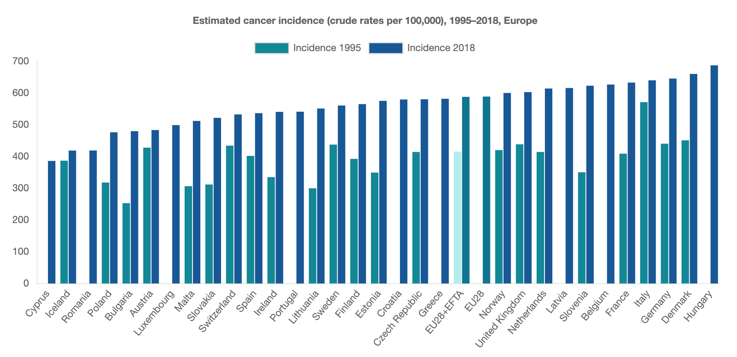
ALL CANCER INCIDENCE 1995 vs 2018
The number of cancer cases has increased over the past two decades. Variation remains across Europe with Hungary recording over 50% more cancer cases per 100,000 population than Cyprus.
Hofmarcher, T et al. (2019) Comparator Report on Cancer in Europe 2019 - Disease Burden, Costs and Access to Medicines. IHE Report 2019:7. IHE: Lund, Sweden. For further information, please follow: https://efpia.eu/cancer-comparator-report/

Slide 3
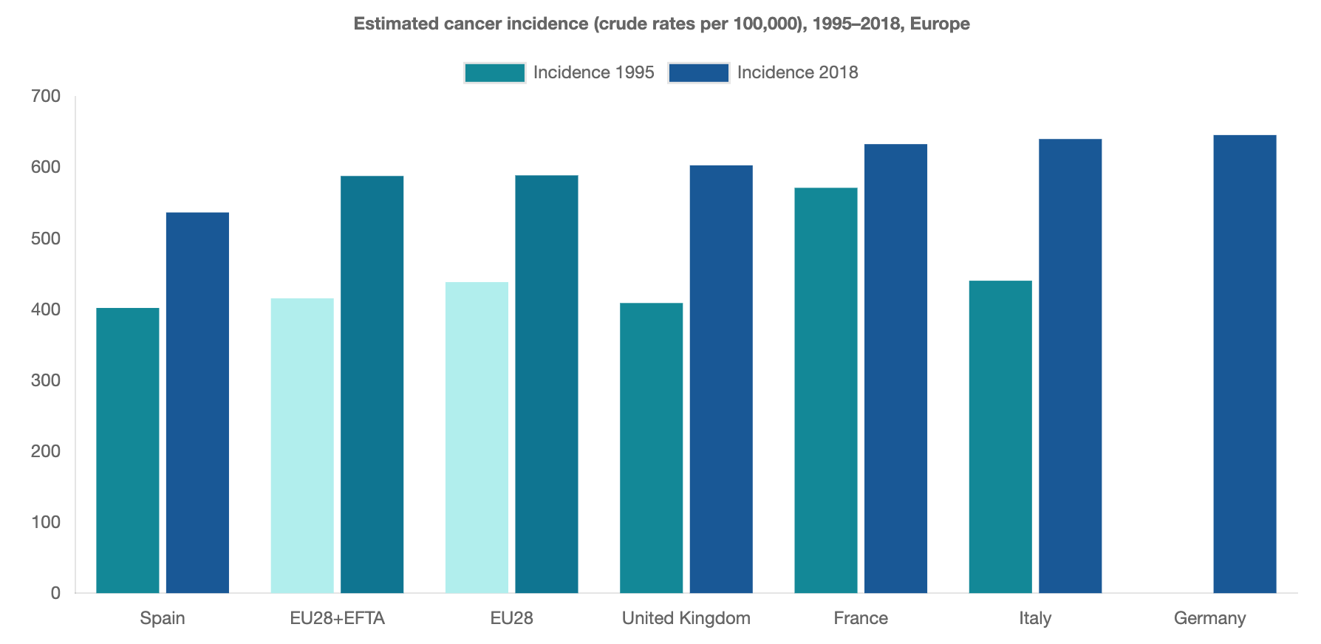
ALL CANCER INCIDENCE 1995 vs 2018
The number of cancer cases has increased over the past two decades. Variation remains across Europe with Hungary recording over 50% more cancer cases per 100,000 population than Cyprus.
Hofmarcher, T et al. (2019) Comparator Report on Cancer in Europe 2019 - Disease Burden, Costs and Access to Medicines. IHE Report 2019:7. IHE: Lund, Sweden. For further information, please follow: https://efpia.eu/cancer-comparator-report/

Slide 4
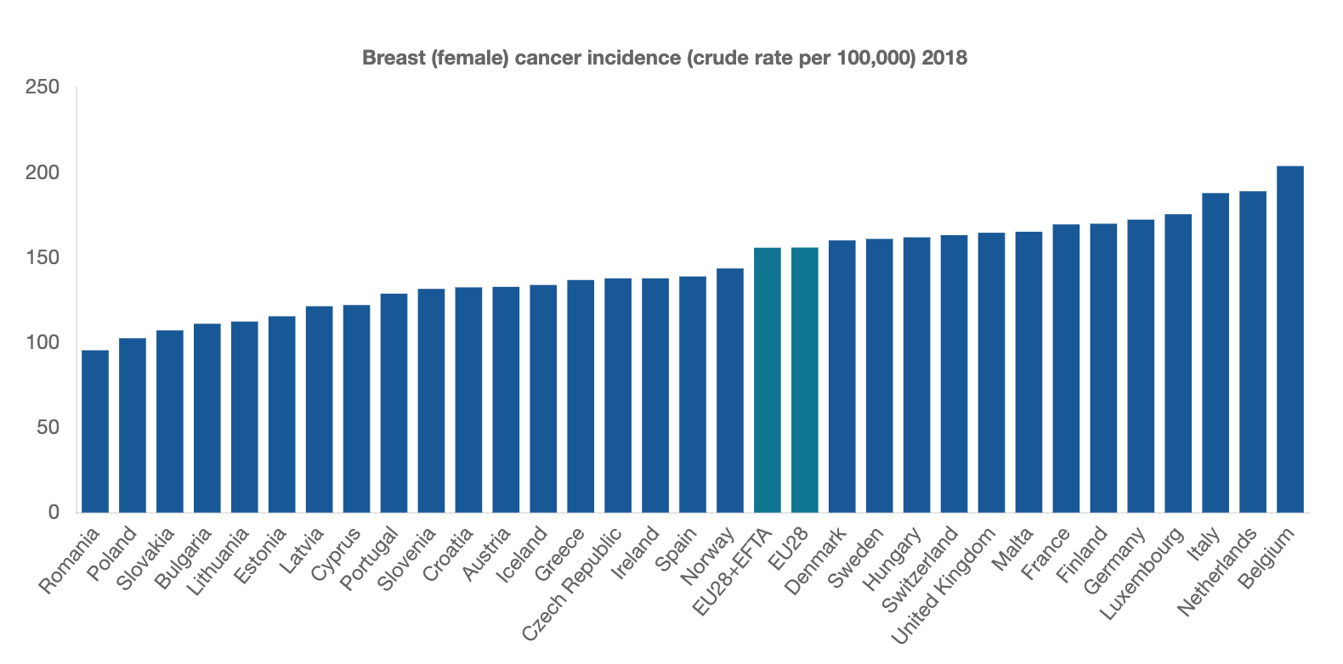
BREAST CANCER INCIDENCE, 2018
The number of people diagnosed with breast cancer in 2018 ranged from 95.4 cases per 100,000 inhabitants in Romania and 203.7 in Belgium, with the EU28+EFTA average at 155.7.
Hofmarcher, T et al. (2019) Comparator Report on Cancer in Europe 2019 - Disease Burden, Costs and Access to Medicines. IHE Report 2019:7. IHE: Lund, Sweden. For further information, please follow: https://efpia.eu/cancer-comparator-report/

Slide 5
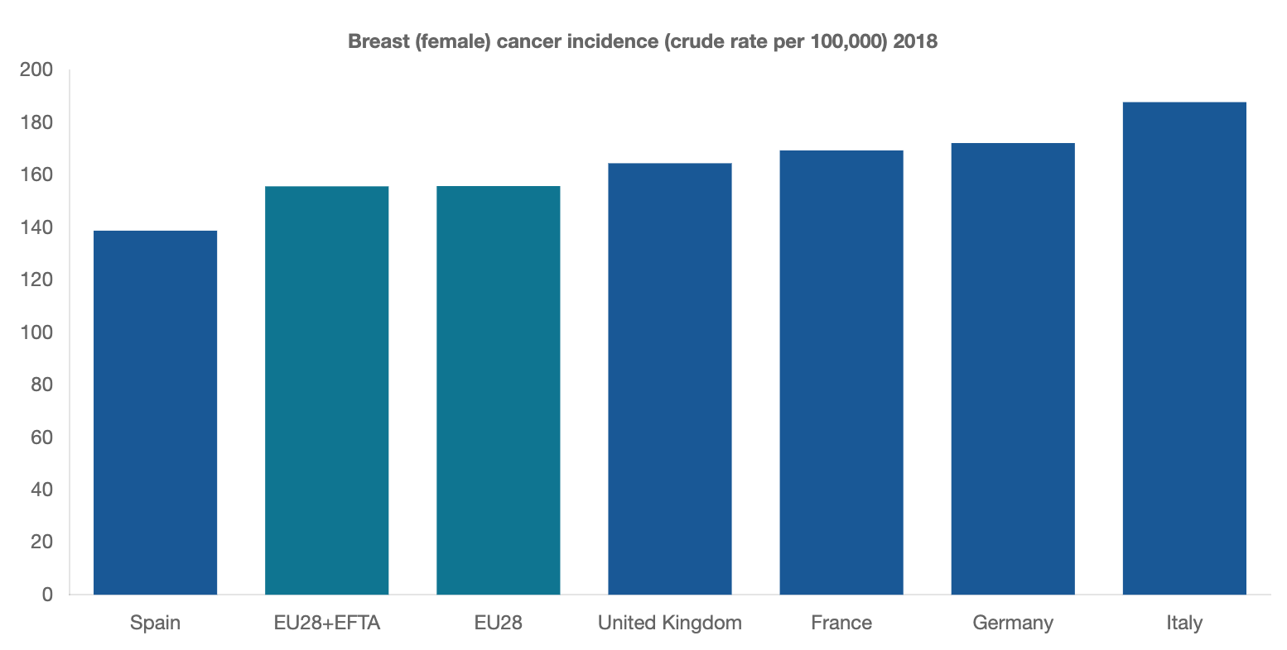
BREAST CANCER INCIDENCE, 2018
The number of people diagnosed with breast cancer in 2018 ranged from 95.4 cases per 100,000 inhabitants in Romania and 203.7 in Belgium, with the EU28+EFTA average at 155.7.
Hofmarcher, T et al. (2019) Comparator Report on Cancer in Europe 2019 - Disease Burden, Costs and Access to Medicines. IHE Report 2019:7. IHE: Lund, Sweden. For further information, please follow: https://efpia.eu/cancer-comparator-report/

Slide 6
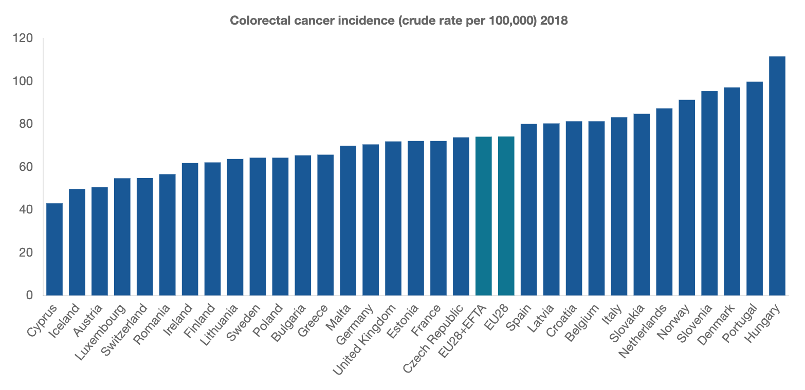
COLON CANCER INCIDENCE, 2018
In 2018, colon cancer incidence ranged from 111.6 per 100,000 inhabitants in Hungary and 43 in Cyprus, with the EU28+EFTA average at 74.1.
Hofmarcher, T et al. (2019) Comparator Report on Cancer in Europe 2019 - Disease Burden, Costs and Access to Medicines. IHE Report 2019:7. IHE: Lund, Sweden. For further information, please follow: https://efpia.eu/cancer-comparator-report/

Slide 7
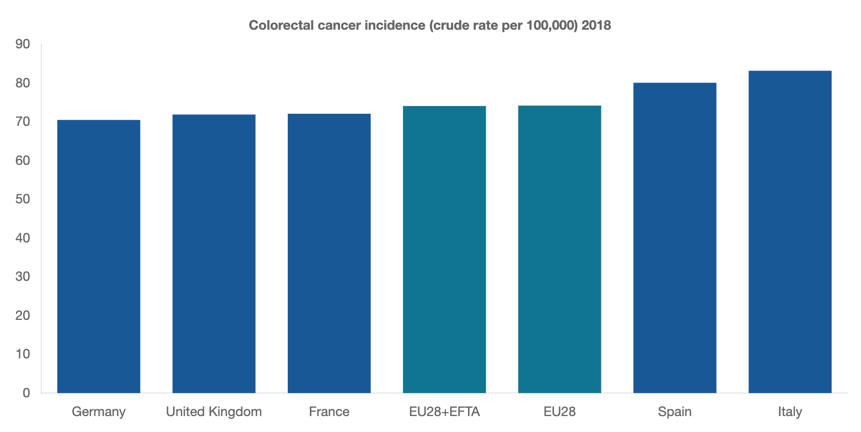
COLON CANCER INCIDENCE, 2018
In 2018, colon cancer incidence ranged from 111.6 per 100,000 inhabitants in Hungary and 43 in Cyprus, with the EU28+EFTA average at 74.1.
Hofmarcher, T et al. (2019) Comparator Report on Cancer in Europe 2019 - Disease Burden, Costs and Access to Medicines. IHE Report 2019:7. IHE: Lund, Sweden. For further information, please follow: https://efpia.eu/cancer-comparator-report/

Slide 8
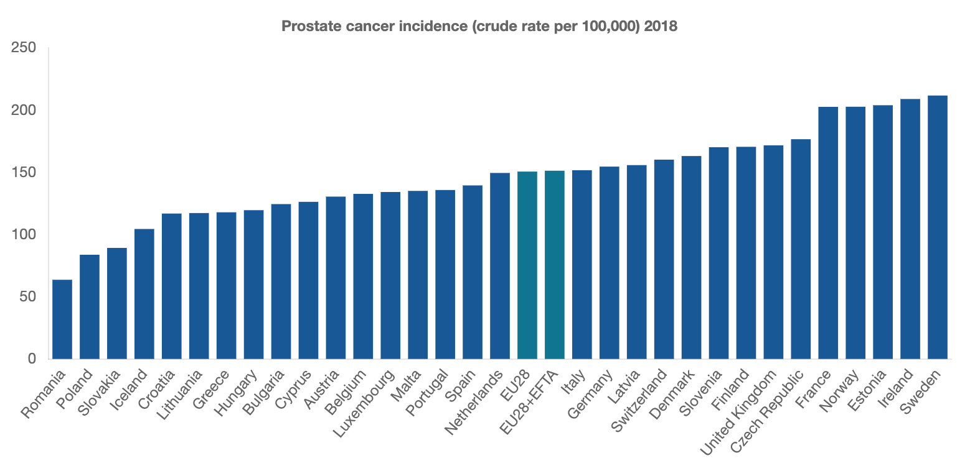
PROSTATE CANCER INCIDENCE, 2018
Prostate cancer incidence has doubled since 1995, surpassing both lung and colorectal cancer incidence with 22% of all newly diagnosed cancer cases in 2018 being diagnosed as prostate cancer. However, it is unclear to what extent the significant increase in prostate cancer incidence is driven by detection of latent disease due to the increase in PSA testing.
In 2018, prostate cancer incidence ranged from 63.6 of 100,000 inhabitants in Romania to 211.6 in Sweden, with the EU28+EFTA average at 151.2.
Hofmarcher, T et al. (2019) Comparator Report on Cancer in Europe 2019 - Disease Burden, Costs and Access to Medicines. IHE Report 2019:7. IHE: Lund, Sweden. For further information, please follow: https://efpia.eu/cancer-comparator-report/

Slide 9
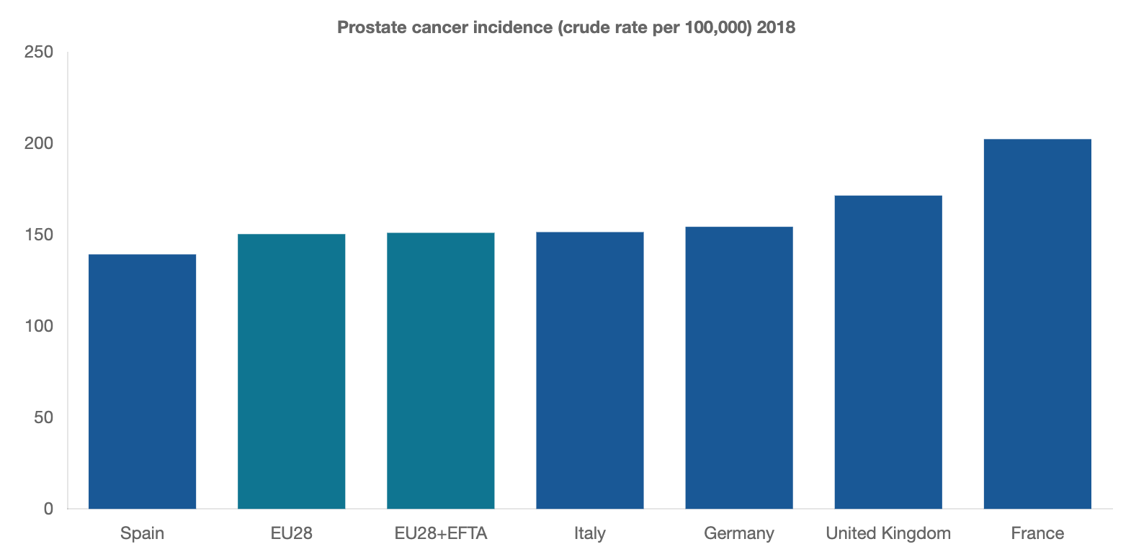
PROSTATE CANCER INCIDENCE, 2018
Prostate cancer incidence has doubled since 1995, surpassing both lung and colorectal cancer incidence with 22% of all newly diagnosed cancer cases in 2018 being diagnosed as prostate cancer. However, it is unclear to what extent the significant increase in prostate cancer incidence is driven by detection of latent disease due to the increase in PSA testing.
In 2018, prostate cancer incidence ranged from 63.6 of 100,000 inhabitants in Romania to 211.6 in Sweden, with the EU28+EFTA average at 151.2.
Hofmarcher, T et al. (2019) Comparator Report on Cancer in Europe 2019 - Disease Burden, Costs and Access to Medicines. IHE Report 2019:7. IHE: Lund, Sweden. For further information, please follow: https://efpia.eu/cancer-comparator-report/

Slide 10
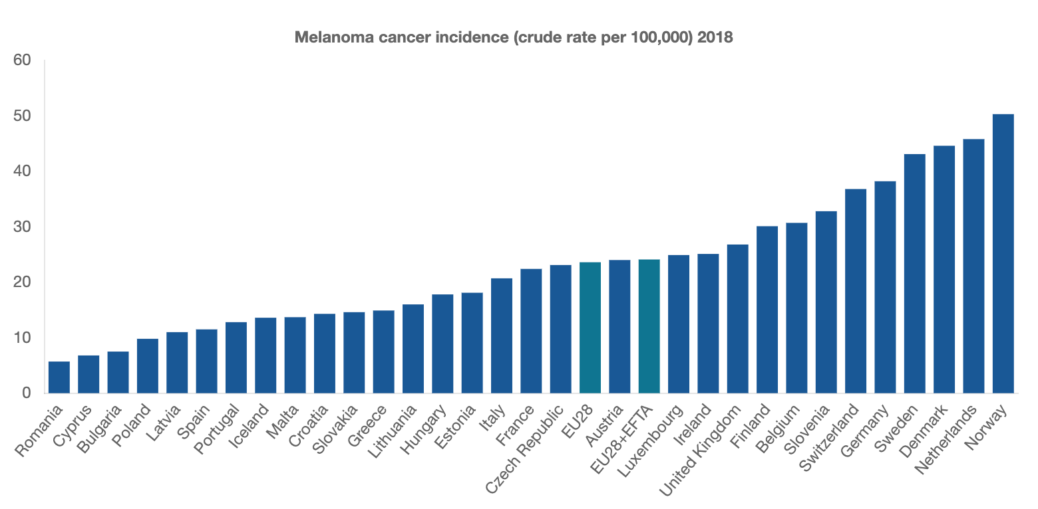
MELANOMA INCIDENCE, 2018
In 2018, melanoma incidence ranged from 5.7 cases per 100,000 inhabitants in Romania to 50.3 in Norway, with the EU28+EFTA average at 24.1.
Hofmarcher, T et al. (2019) Comparator Report on Cancer in Europe 2019 - Disease Burden, Costs and Access to Medicines. IHE Report 2019:7. IHE: Lund, Sweden. For further information, please follow: https://efpia.eu/cancer-comparator-report/

Slide 11
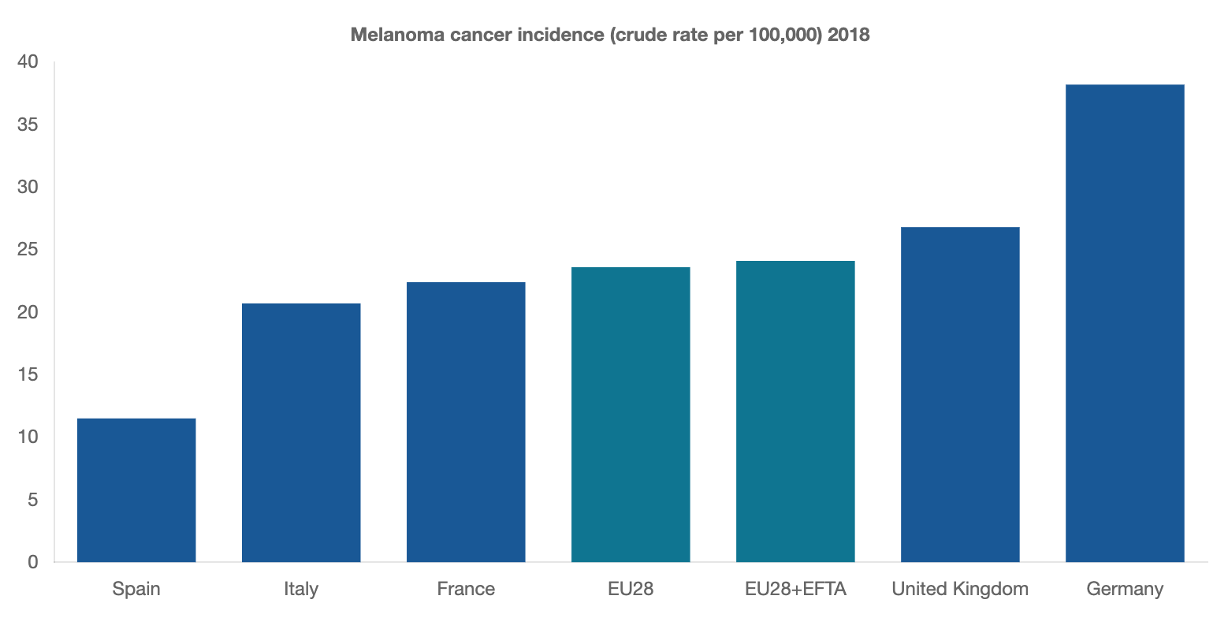
MELANOMA INCIDENCE, 2018
In 2018, melanoma incidence ranged from 5.7 cases per 100,000 inhabitants in Romania to 50.3 in Norway, with the EU28+EFTA average at 24.1.
Hofmarcher, T et al. (2019) Comparator Report on Cancer in Europe 2019 - Disease Burden, Costs and Access to Medicines. IHE Report 2019:7. IHE: Lund, Sweden. For further information, please follow: https://efpia.eu/cancer-comparator-report/

Slide 12
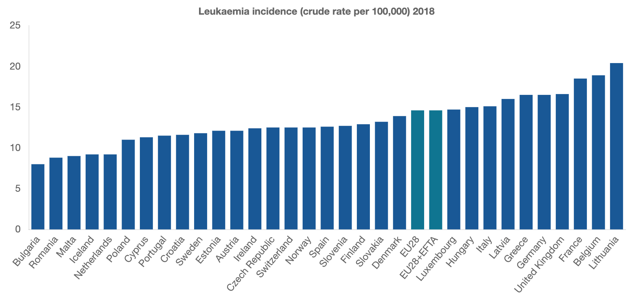
LEUKAEMIA INCIDENCE, 2018
In 2018, leukaemia incidence ranged from 8 cases per 100,000 inhabitants in Bulgaria to 20.4 in Lithuania, with the EU28+EFTA average at 14.6.
Hofmarcher, T et al. (2019) Comparator Report on Cancer in Europe 2019 - Disease Burden, Costs and Access to Medicines. IHE Report 2019:7. IHE: Lund, Sweden. For further information, please follow: https://efpia.eu/cancer-comparator-report/

Slide 13
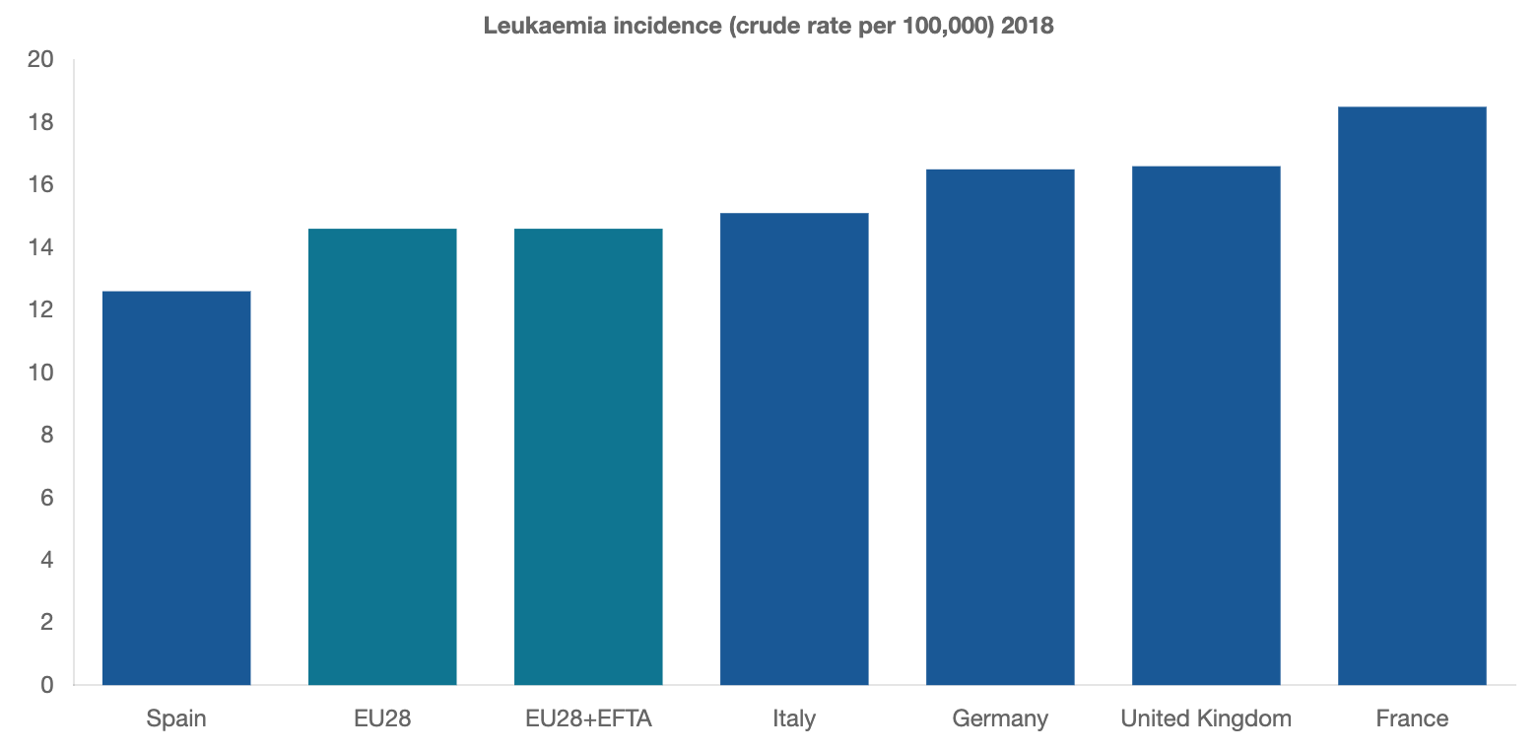
LEUKAEMIA INCIDENCE, 2018
In 2018, leukaemia incidence ranged from 8 cases per 100,000 inhabitants in Bulgaria to 20.4 in Lithuania, with the EU28+EFTA average at 14.6.
Hofmarcher, T et al. (2019) Comparator Report on Cancer in Europe 2019 - Disease Burden, Costs and Access to Medicines. IHE Report 2019:7. IHE: Lund, Sweden. For further information, please follow: https://efpia.eu/cancer-comparator-report/

Slide 14
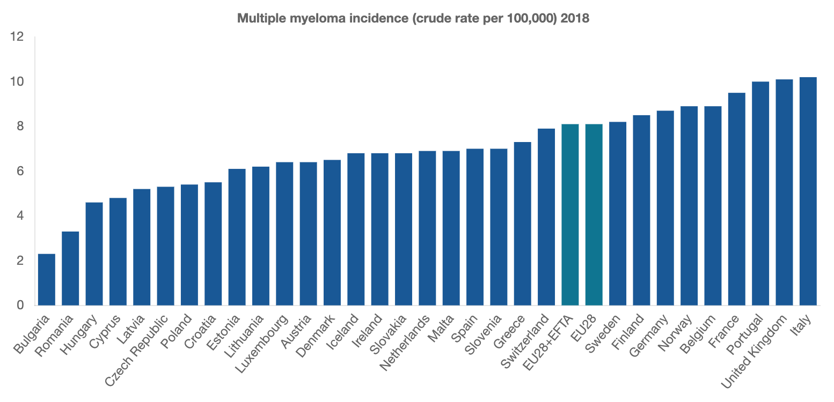
LEUKAEMIA INCIDENCE, 2018 Multiple myeloma Incidence
In 2018, multiple myeloma incidence ranged from 2.3 cases per 100,000 inhabitants in Bulgaria to 10.2 in Italy, with the EU28+EFTA average at 8.1.
Hofmarcher, T et al. (2019) Comparator Report on Cancer in Europe 2019 - Disease Burden, Costs and Access to Medicines. IHE Report 2019:7. IHE: Lund, Sweden. For further information, please follow: https://efpia.eu/cancer-comparator-report/

Slide 15
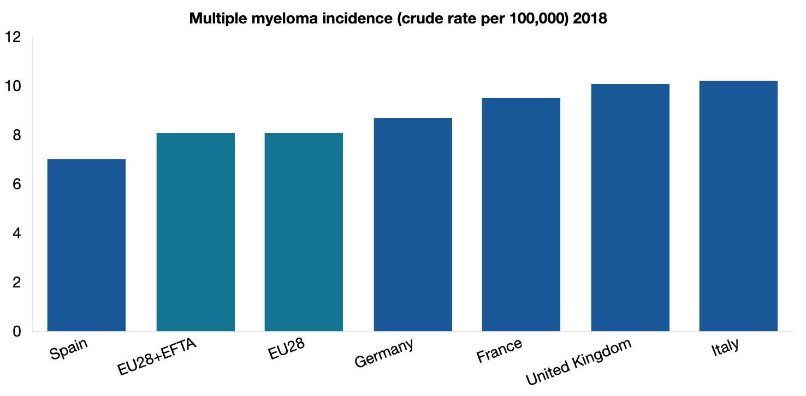
LEUKAEMIA INCIDENCE, 2018 Multiple myeloma Incidence
In 2018, multiple myeloma incidence ranged from 2.3 cases per 100,000 inhabitants in Bulgaria to 10.2 in Italy, with the EU28+EFTA average at 8.1.
Hofmarcher, T et al. (2019) Comparator Report on Cancer in Europe 2019 - Disease Burden, Costs and Access to Medicines. IHE Report 2019:7. IHE: Lund, Sweden. For further information, please follow: https://efpia.eu/cancer-comparator-report/

Slide 16
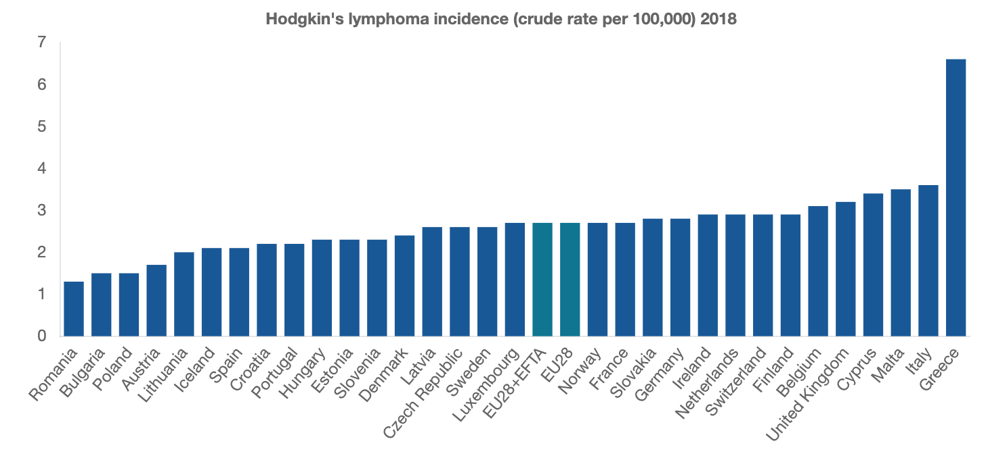
LEUKAEMIA INCIDENCE, 2018 Hodgkin’s Lymphoma Incidence
In 2018, Hodgkin’s lymphoma incidence ranged from 1.3 cases per 100,000 inhabitants in Romania to 6.6 in Greece, with the EU28+EFTA average at 2.7.
Hofmarcher, T et al. (2019) Comparator Report on Cancer in Europe 2019 - Disease Burden, Costs and Access to Medicines. IHE Report 2019:7. IHE: Lund, Sweden. For further information, please follow: https://efpia.eu/cancer-comparator-report/

Slide 17
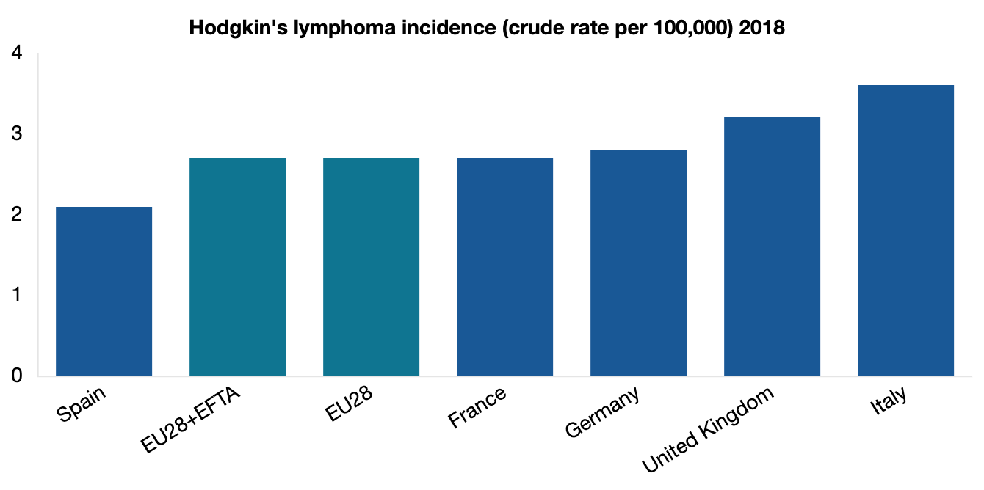
LEUKAEMIA INCIDENCE, 2018 Hodgkin’s Lymphoma Incidence
In 2018, Hodgkin’s lymphoma incidence ranged from 1.3 cases per 100,000 inhabitants in Romania to 6.6 in Greece, with the EU28+EFTA average at 2.7.
Hofmarcher, T et al. (2019) Comparator Report on Cancer in Europe 2019 - Disease Burden, Costs and Access to Medicines. IHE Report 2019:7. IHE: Lund, Sweden. For further information, please follow: https://efpia.eu/cancer-comparator-report/

Slide 18
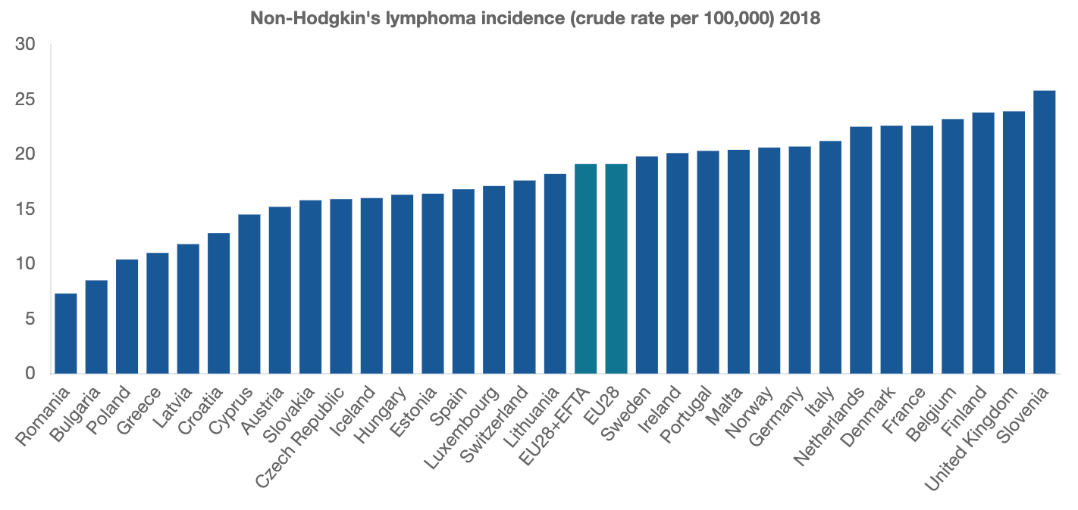
LEUKAEMIA INCIDENCE, 2018 Non-Hodgkin’s Lymphoma Incidence
In 2018, Non-Hodgkin’s lymphoma incidence ranged from 7.3 cases per 100,000 inhabitants in Romania to 25.8 in Slovenia, with the EU28+EFTA average at 19.1.
Hofmarcher, T et al. (2019) Comparator Report on Cancer in Europe 2019 - Disease Burden, Costs and Access to Medicines. IHE Report 2019:7. IHE: Lund, Sweden. For further information, please follow: https://efpia.eu/cancer-comparator-report/

Slide 19
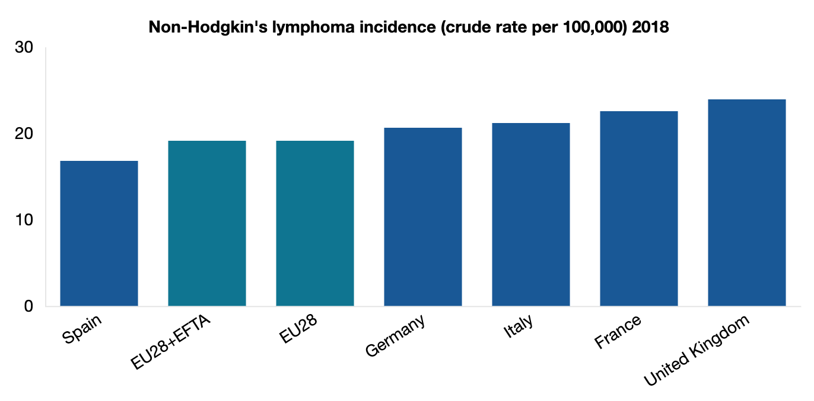
LEUKAEMIA INCIDENCE, 2018 Non-Hodgkin’s Lymphoma Incidence
In 2018, Non-Hodgkin’s lymphoma incidence ranged from 7.3 cases per 100,000 inhabitants in Romania to 25.8 in Slovenia, with the EU28+EFTA average at 19.1.
Hofmarcher, T et al. (2019) Comparator Report on Cancer in Europe 2019 - Disease Burden, Costs and Access to Medicines. IHE Report 2019:7. IHE: Lund, Sweden. For further information, please follow: https://efpia.eu/cancer-comparator-report/

Slide 20
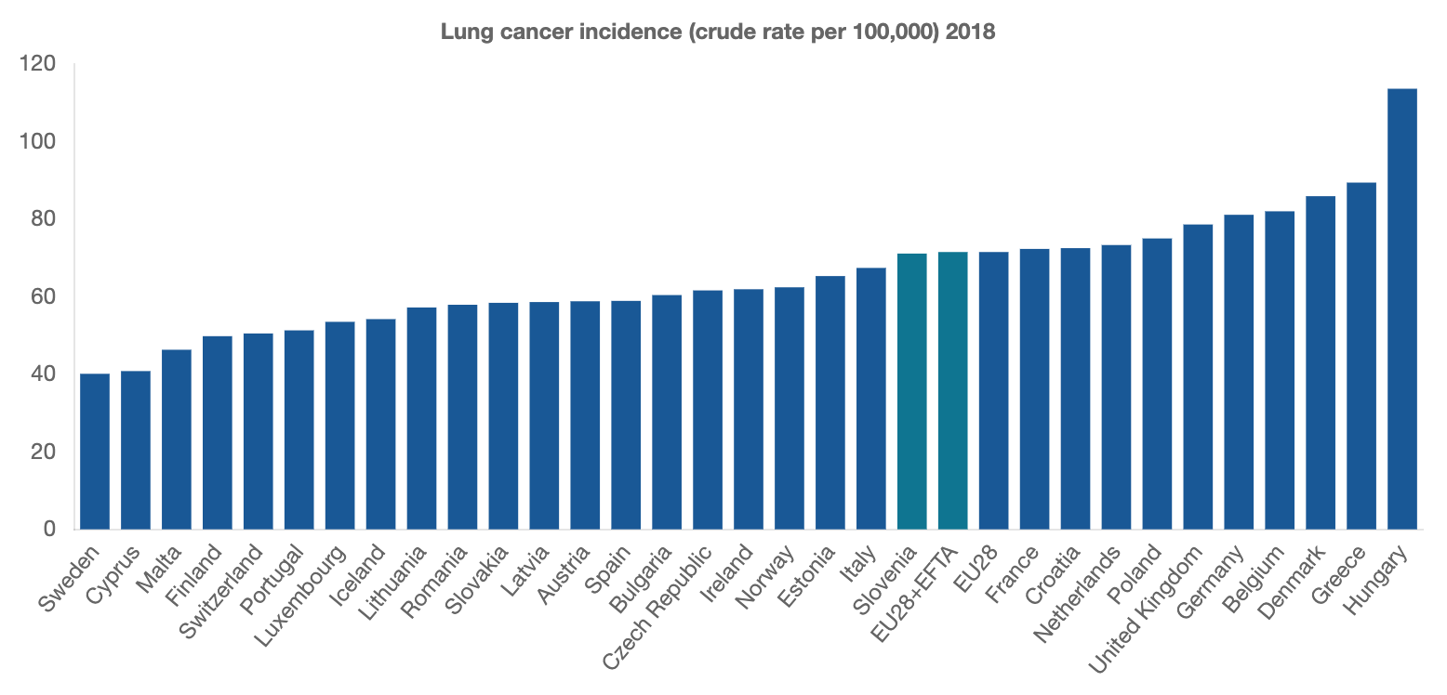
LUNG CANCER INCIDENCE, 2018
In 2018, lung cancer incidence ranged from 40.1 cases per 100,000 inhabitants in Sweden to 113.6 in Hungary, with the EU28+EFTA average at 71.1.
Hofmarcher, T et al. (2019) Comparator Report on Cancer in Europe 2019 - Disease Burden, Costs and Access to Medicines. IHE Report 2019:7. IHE: Lund, Sweden. For further information, please follow: https://efpia.eu/cancer-comparator-report/

Slide 21
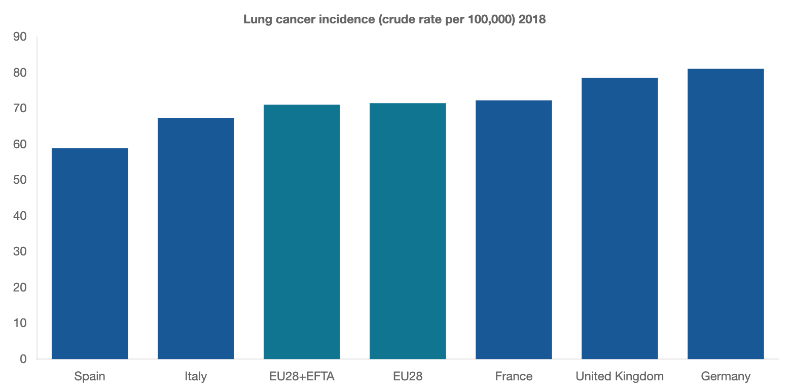
LUNG CANCER INCIDENCE, 2018
In 2018, lung cancer incidence ranged from 40.1 cases per 100,000 inhabitants in Sweden to 113.6 in Hungary, with the EU28+EFTA average at 71.1.
Hofmarcher, T et al. (2019) Comparator Report on Cancer in Europe 2019 - Disease Burden, Costs and Access to Medicines. IHE Report 2019:7. IHE: Lund, Sweden. For further information, please follow: https://efpia.eu/cancer-comparator-report/

Slide 22
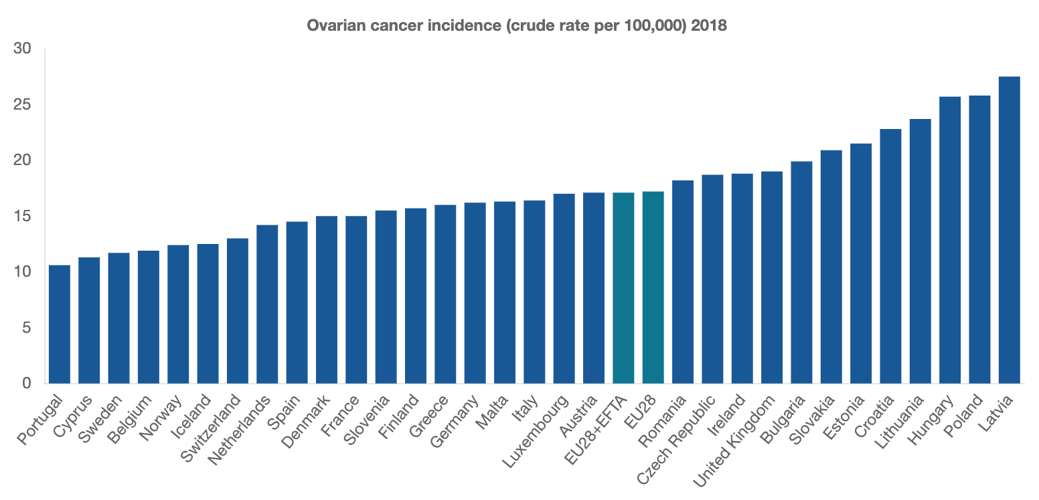
OVARIAN CANCER INCIDENCE, 2018
In 2018, ovarian cancer incidence ranged from 10.6 cases per 100,000 inhabitants in Portugal to 27.5 in Latvia, with the EU28+EFTA average at 17.1.
Hofmarcher, T et al. (2019) Comparator Report on Cancer in Europe 2019 - Disease Burden, Costs and Access to Medicines. IHE Report 2019:7. IHE: Lund, Sweden. For further information, please follow: https://efpia.eu/cancer-comparator-report/

Slide 23
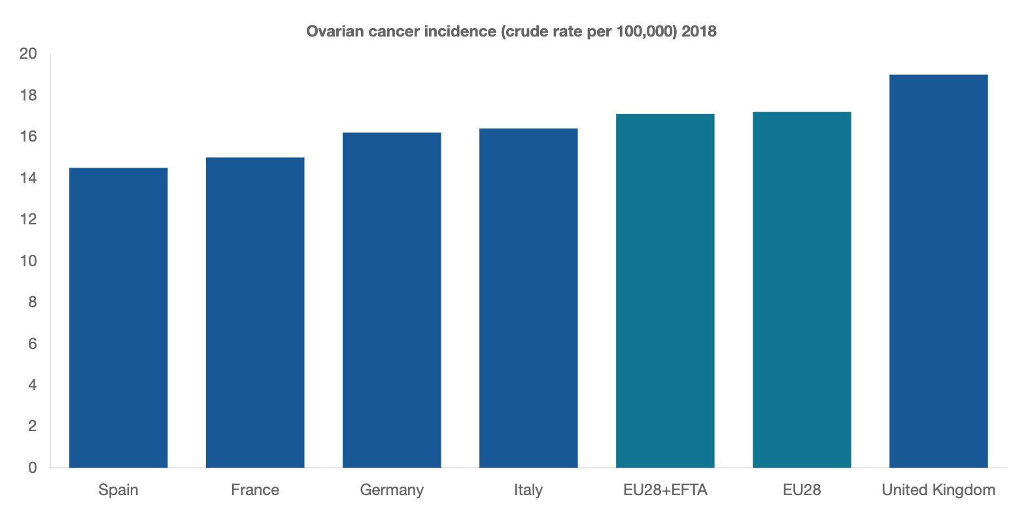
OVARIAN CANCER INCIDENCE, 2018
In 2018, ovarian cancer incidence ranged from 10.6 cases per 100,000 inhabitants in Portugal to 27.5 in Latvia, with the EU28+EFTA average at 17.1.
Hofmarcher, T et al. (2019) Comparator Report on Cancer in Europe 2019 - Disease Burden, Costs and Access to Medicines. IHE Report 2019:7. IHE: Lund, Sweden. For further information, please follow: https://efpia.eu/cancer-comparator-report/

Slide 24
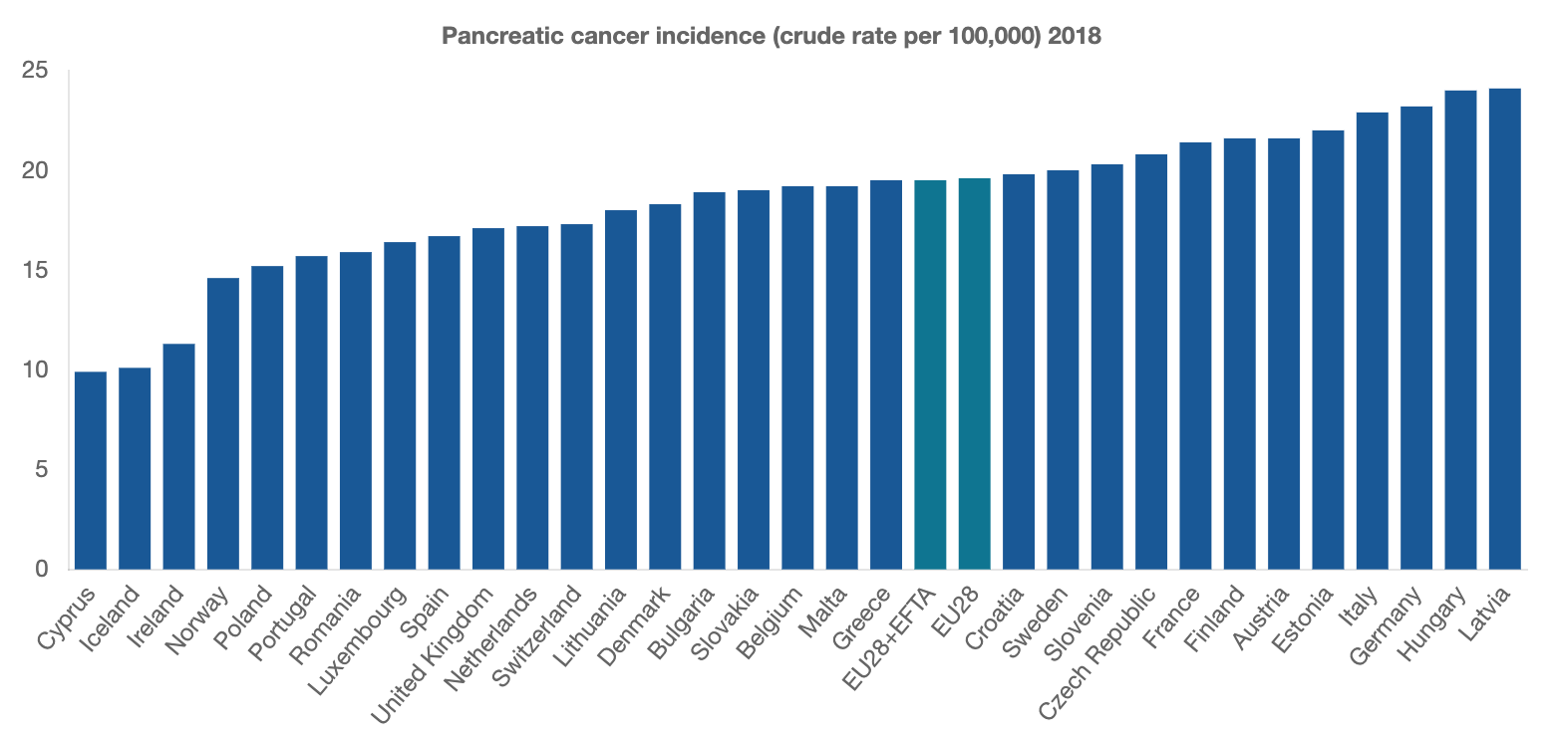
PANCREATIC CANCER INCIDENCE, 2018
In 2018, pancreatic cancer incidence ranged from 9.9 cases per 100,000 in Cyprus to 24.1 in Latvia, with the EU28+EFTA average at 19.5.
Hofmarcher, T et al. (2019) Comparator Report on Cancer in Europe 2019 - Disease Burden, Costs and Access to Medicines. IHE Report 2019:7. IHE: Lund, Sweden. For further information, please follow: https://efpia.eu/cancer-comparator-report/

Slide 25
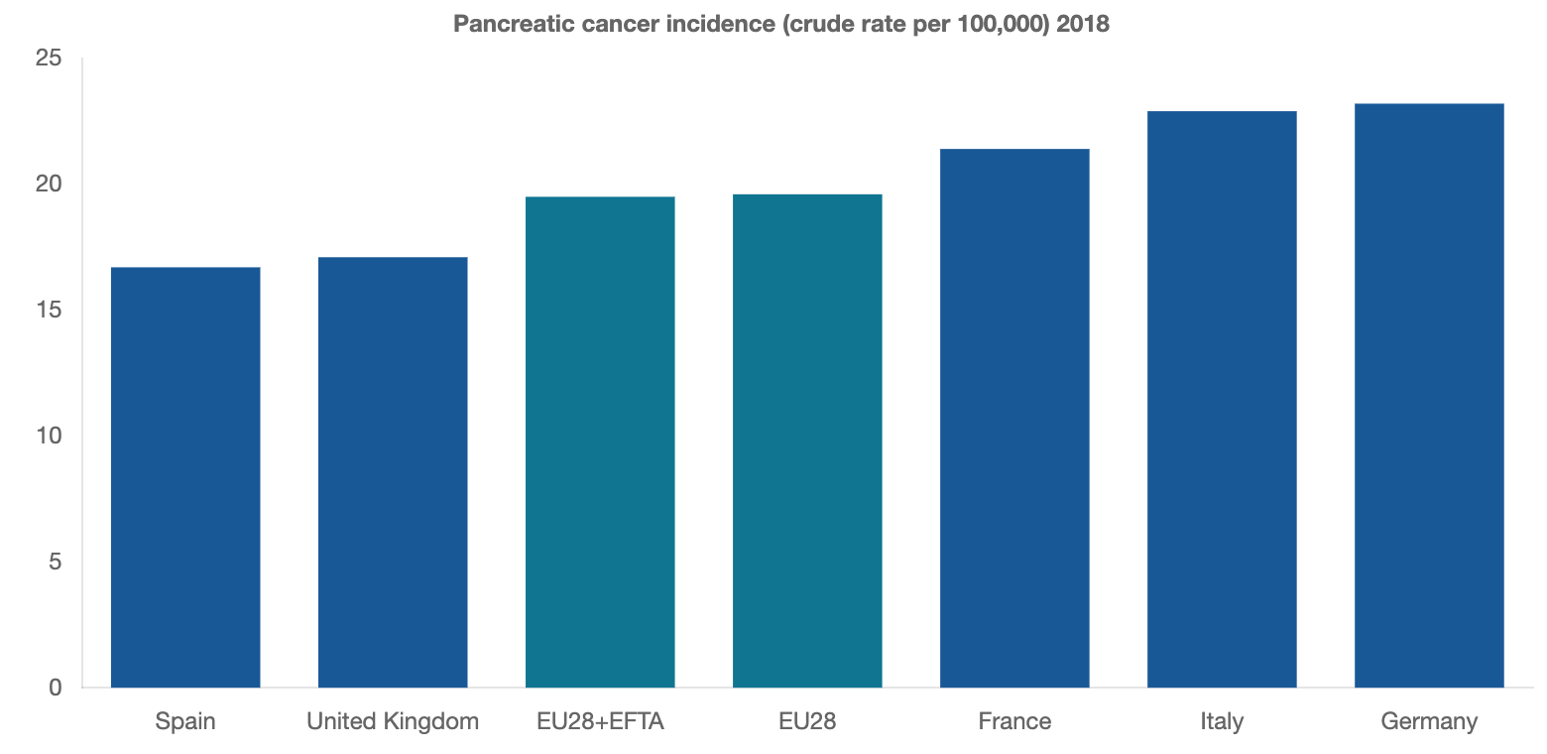
PANCREATIC CANCER INCIDENCE, 2018
In 2018, pancreatic cancer incidence ranged from 9.9 cases per 100,000 in Cyprus to 24.1 in Latvia, with the EU28+EFTA average at 19.5.
Hofmarcher, T et al. (2019) Comparator Report on Cancer in Europe 2019 - Disease Burden, Costs and Access to Medicines. IHE Report 2019:7. IHE: Lund, Sweden. For further information, please follow: https://efpia.eu/cancer-comparator-report/

