Slide 1
CANCER CARE

Slide 2
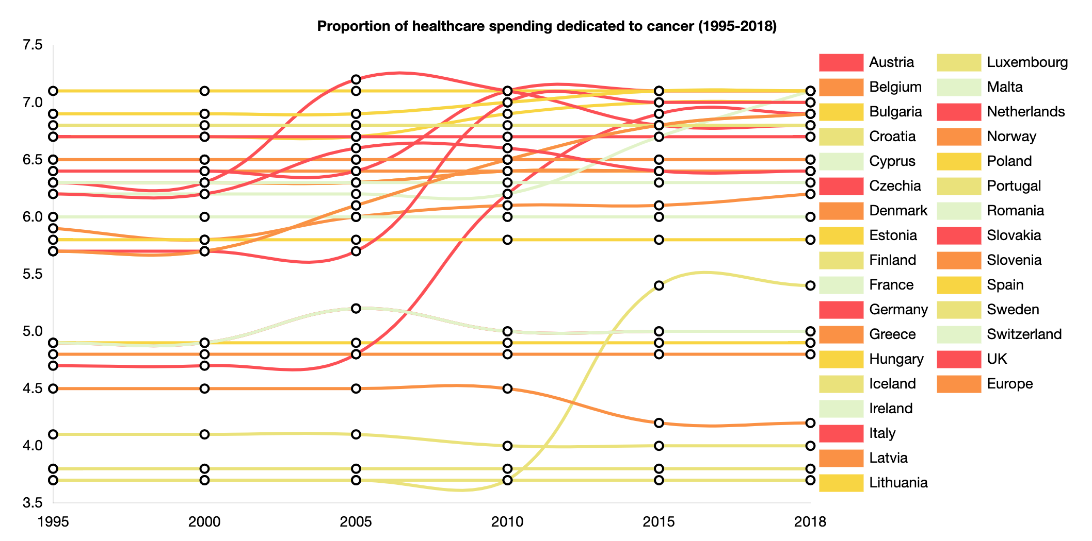
% OF OVERALL HEALTHCARE BUDGET
The overall share of the total health budget dedicated to cancer care has remained stable over the past 20 years.
Hofmarcher, T et al. (2019) Comparator Report on Cancer in Europe 2019 - Disease Burden, Costs and Access to Medicines. IHE Report 2019:7. IHE: Lund, Sweden. For further information, please follow: https://efpia.eu/cancer-comparator-report/

Slide 3
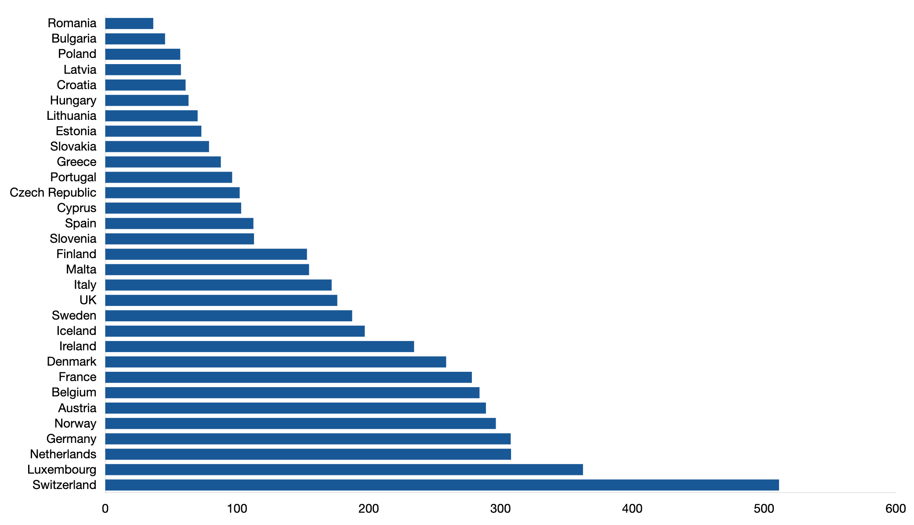
DIRECT COST OF CANCER
There is significant variation in the direct investment in cancer care across Europe with Switzerland spending over 10 times the amount that Romania spends per capita.
Hofmarcher, T et al. (2019) Comparator Report on Cancer in Europe 2019 - Disease Burden, Costs and Access to Medicines. IHE Report 2019:7. IHE: Lund, Sweden. For further information, please follow: https://efpia.eu/cancer-comparator-report/

Slide 4
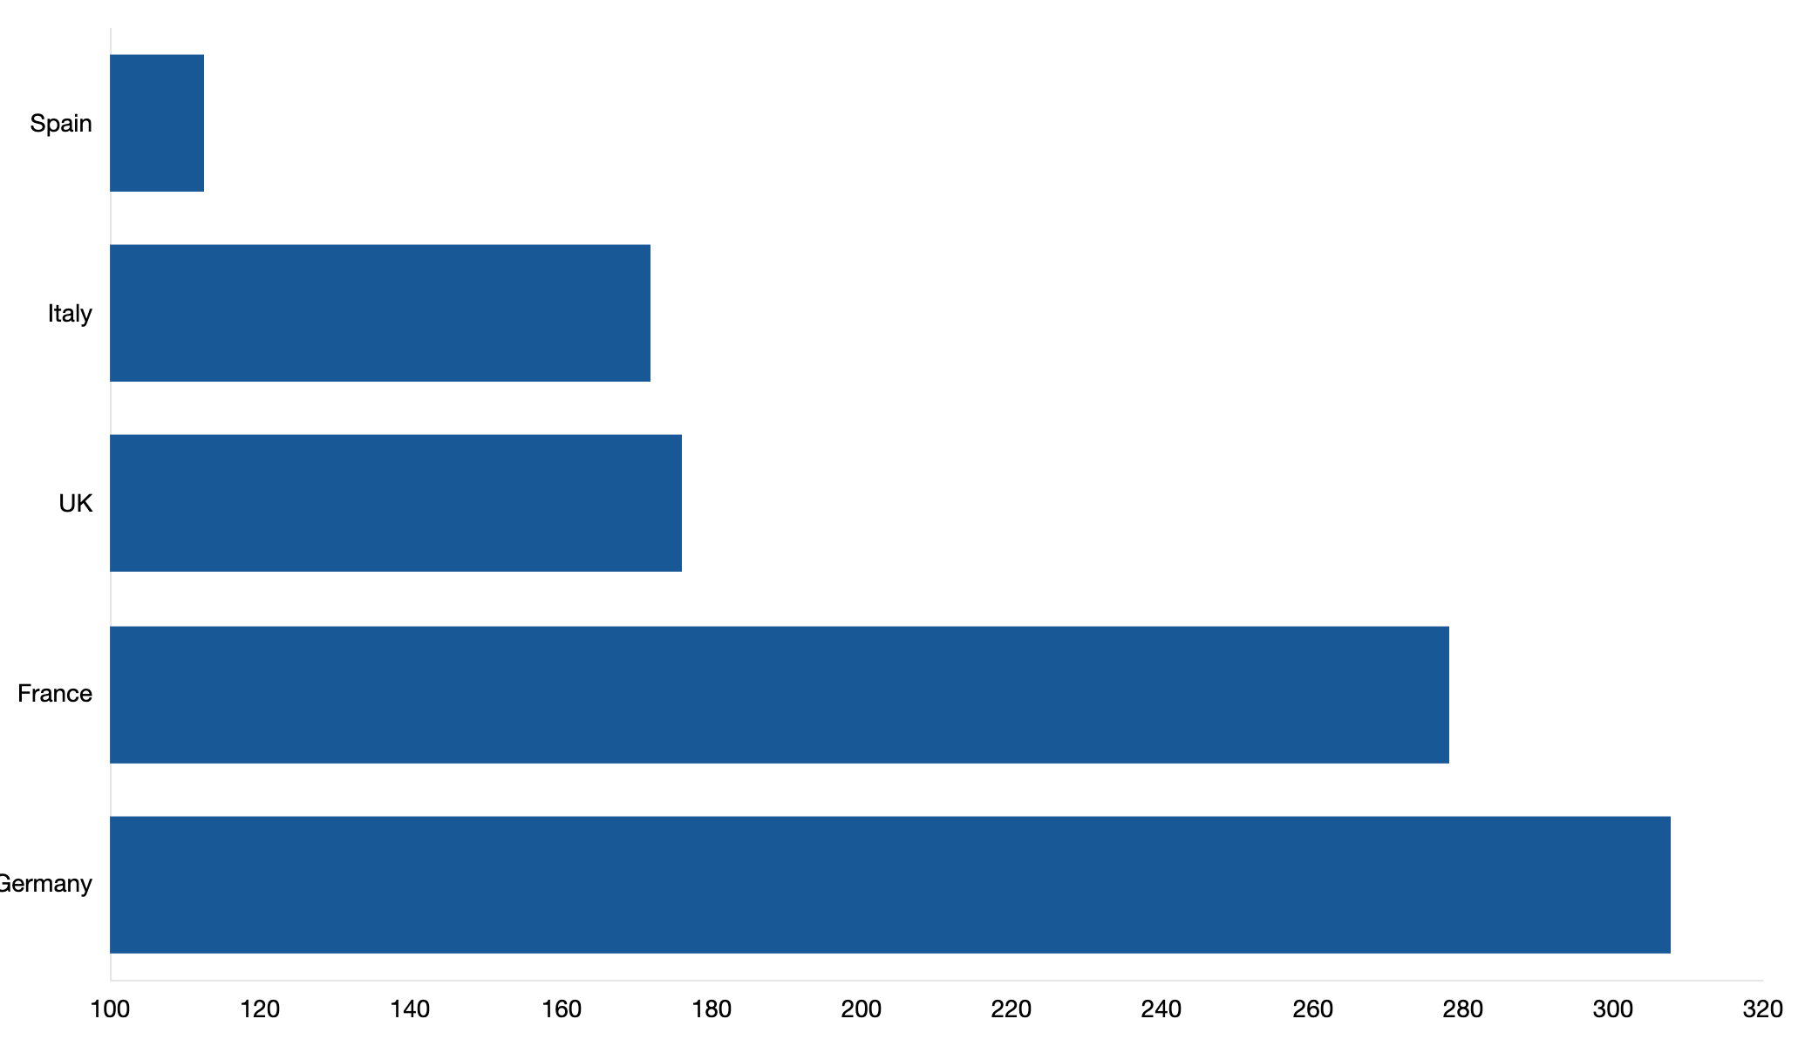
DIRECT COST OF CANCER
There is significant variation in the direct investment in cancer care across Europe with Switzerland spending over 10 times the amount that Romania spends per capita.
Hofmarcher, T et al. (2019) Comparator Report on Cancer in Europe 2019 - Disease Burden, Costs and Access to Medicines. IHE Report 2019:7. IHE: Lund, Sweden. For further information, please follow: https://efpia.eu/cancer-comparator-report/

Slide 5
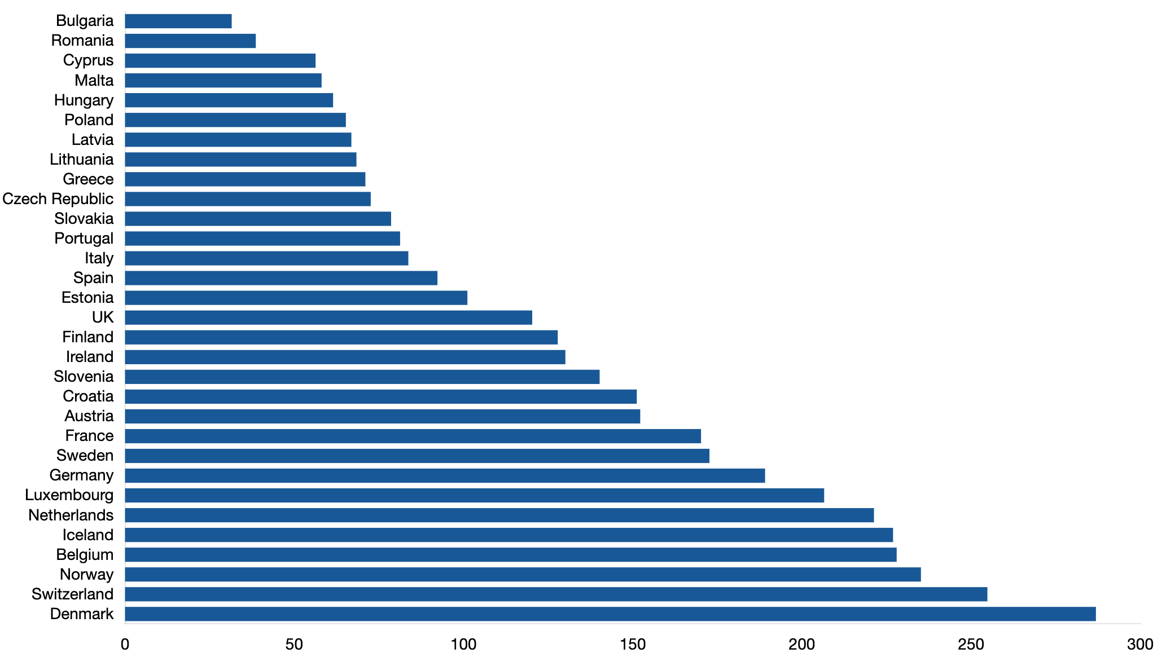
INDIRECT COST OF CANCER
Direct investment in cancer care has further resulted in a 9% reduction in costs associated with the wider impact of the disease, such as lost or reduced productivity. Through more effective treatment and management of the condition, those affected are able to return to the workforce earlier, benefiting not only the patient but also their family and society overall.
Hofmarcher, T et al. (2019) Comparator Report on Cancer in Europe 2019 - Disease Burden, Costs and Access to Medicines. IHE Report 2019:7. IHE: Lund, Sweden. For further information, please follow: https://efpia.eu/cancer-comparator-report/

Slide 6
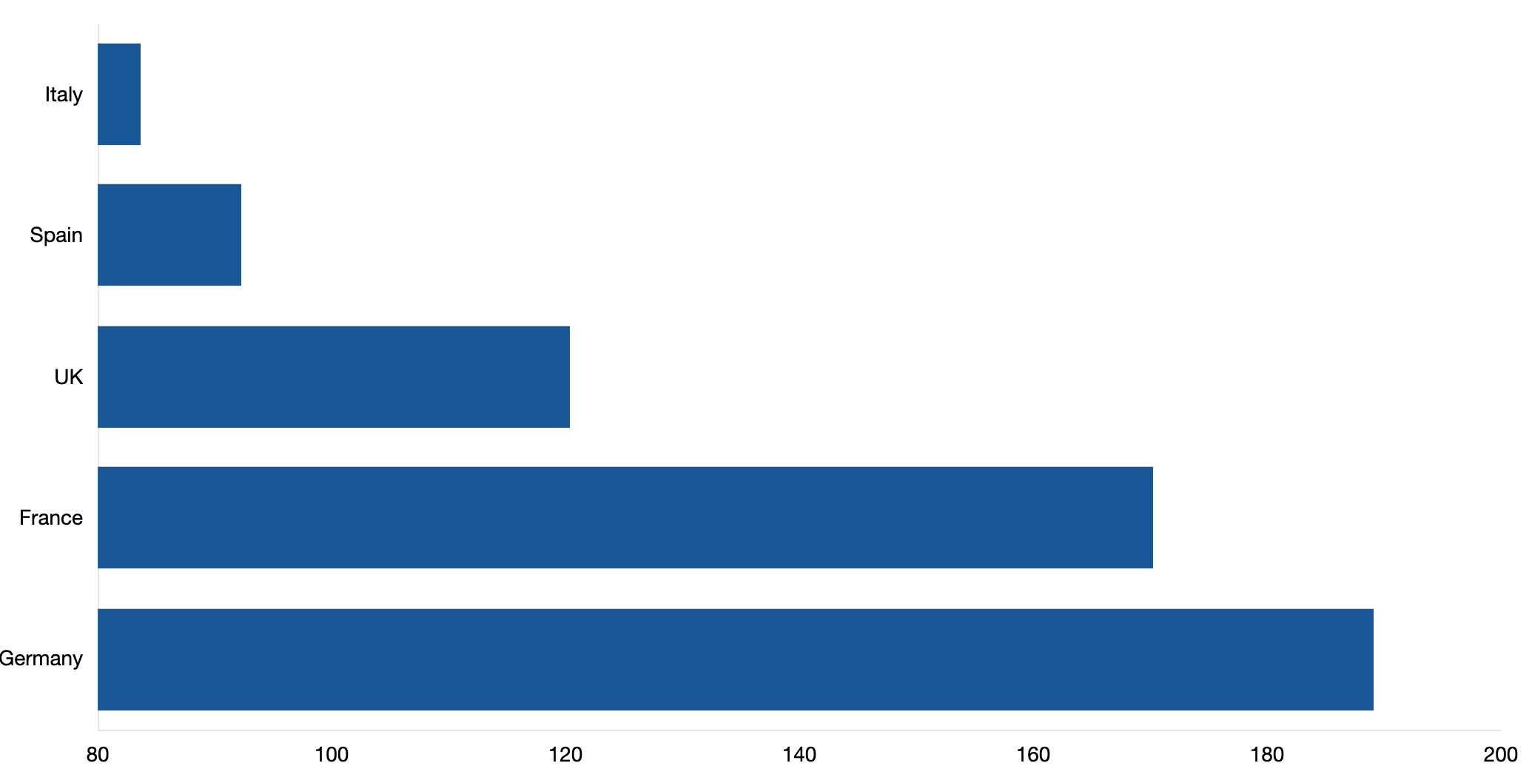
INDIRECT COST OF CANCER
Direct investment in cancer care has further resulted in a 9% reduction in costs associated with the wider impact of the disease, such as lost or reduced productivity. Through more effective treatment and management of the condition, those affected are able to return to the workforce earlier, benefiting not only the patient but also their family and society overall.
Hofmarcher, T et al. (2019) Comparator Report on Cancer in Europe 2019 - Disease Burden, Costs and Access to Medicines. IHE Report 2019:7. IHE: Lund, Sweden. For further information, please follow: https://efpia.eu/cancer-comparator-report/

Slide 7
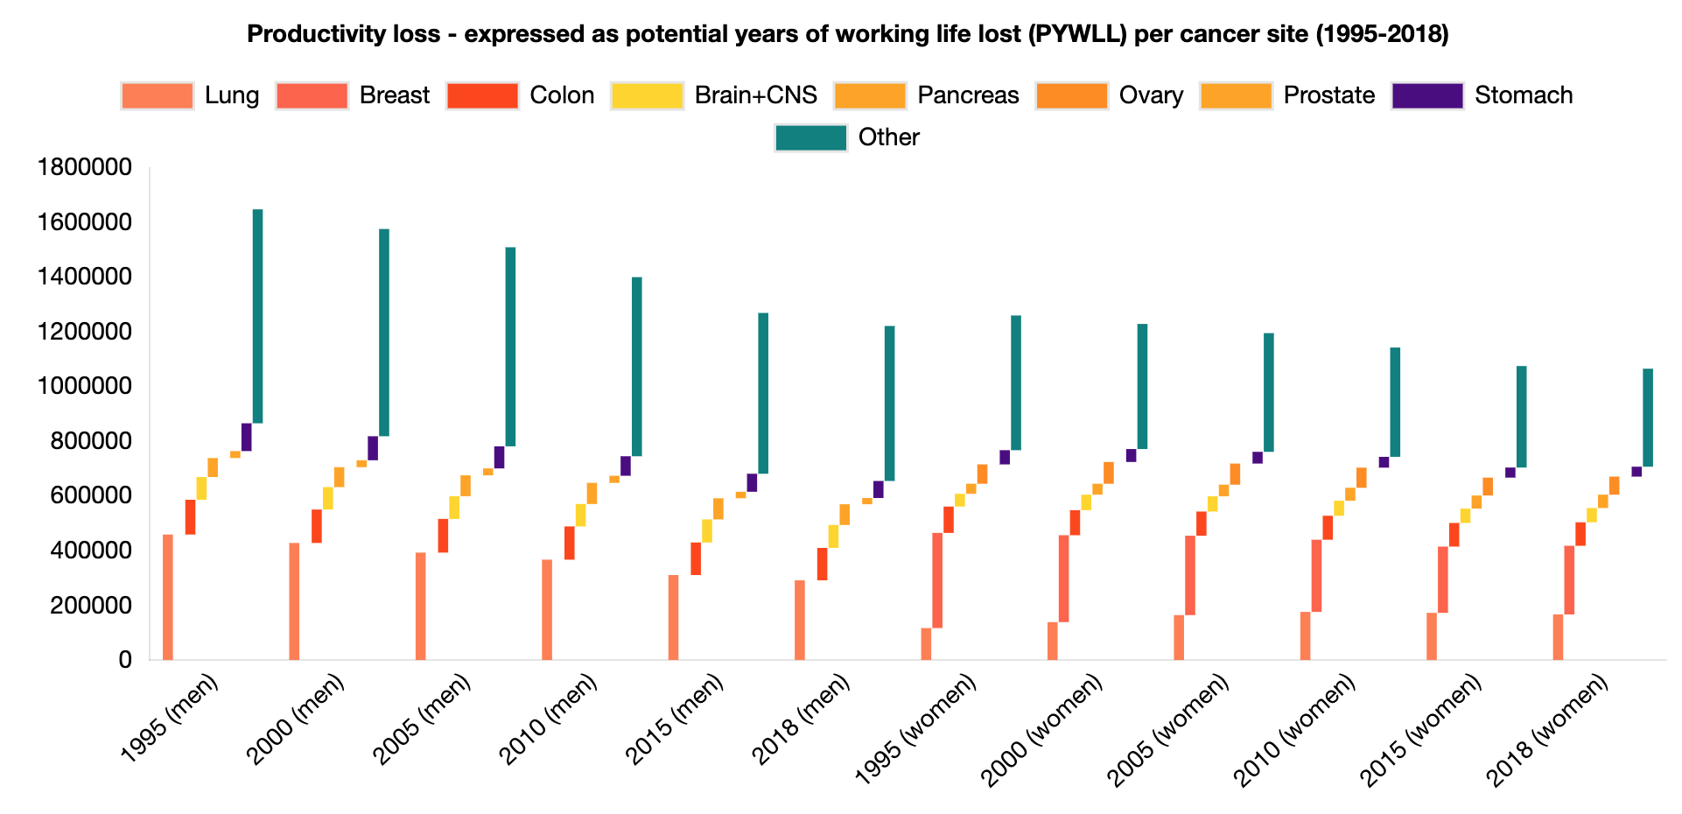
INDIRECT COST OF CANCER
Direct investment in cancer care has further resulted in a 9% reduction in costs associated with the wider impact of the disease, such as lost or reduced productivity. Through more effective treatment and management of the condition, those affected are able to return to the workforce earlier, benefiting not only the patient but also their family and society overall.
Hofmarcher, T et al. (2019) Comparator Report on Cancer in Europe 2019 - Disease Burden, Costs and Access to Medicines. IHE Report 2019:7. IHE: Lund, Sweden. For further information, please follow: https://efpia.eu/cancer-comparator-report/

Slide 8
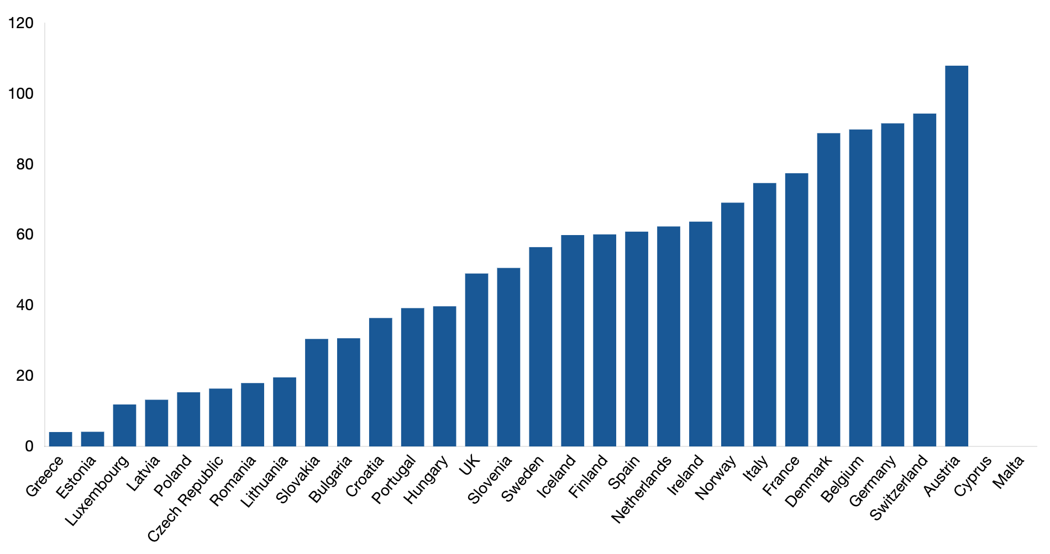
CANCER MEDECINES SPEND
Western European countries tend to spend significantly more on cancer medicines than Eastern European countries.
Hofmarcher, T et al. (2019) Comparator Report on Cancer in Europe 2019 - Disease Burden, Costs and Access to Medicines. IHE Report 2019:7. IHE: Lund, Sweden. For further information, please follow: https://efpia.eu/cancer-comparator-report/

Slide 9
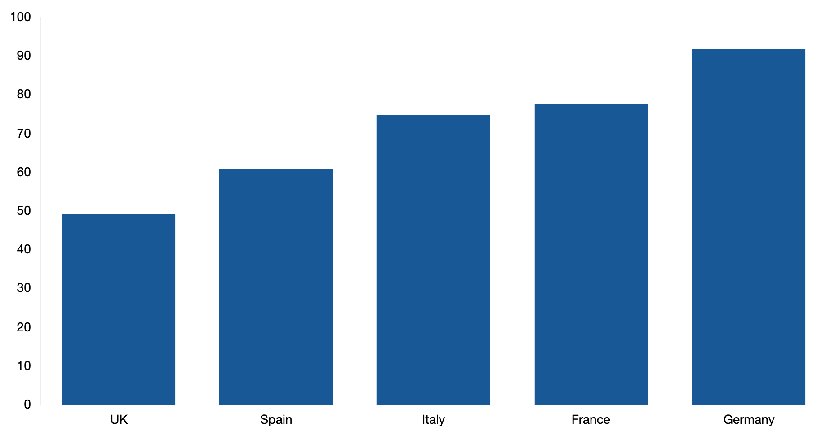
CANCER MEDECINES SPEND
Western European countries tend to spend significantly more on cancer medicines than Eastern European countries.
Hofmarcher, T et al. (2019) Comparator Report on Cancer in Europe 2019 - Disease Burden, Costs and Access to Medicines. IHE Report 2019:7. IHE: Lund, Sweden. For further information, please follow: https://efpia.eu/cancer-comparator-report/

Slide 10
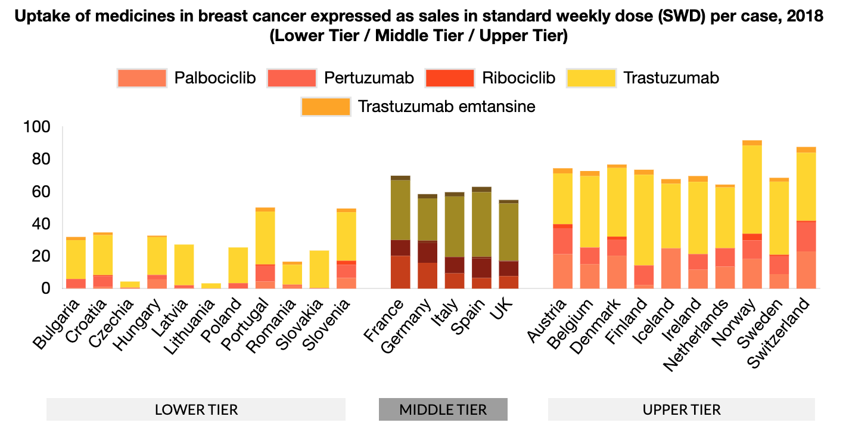
MEDICINES UPTAKE Breast Cancer Medicines
There has been a distinct increase in the number of approved cancer medicines and indications in recent years. Treatments for over 160 indications were approved since 1995. However, variation in cancer medicine uptake across Europe suggests differing levels of patient access to treatment.
Countries with a lower GDP recorded around one third to half of the level of uptake (in volume) of the EU-5 countries and other countries with a higher GDP. Among the EU-5, the UK showed a consistent pattern of the lowest level of uptake across the seven cancer types considered in this report, including immunotherapy. France and Germany had the highest level of uptake among the EU-5.
For more information on cancer medicines in Europe, you can access the report here.
Hofmarcher, T et al. (2019) Comparator Report on Cancer in Europe 2019 - Disease Burden, Costs and Access to Medicines. IHE Report 2019:7. IHE: Lund, Sweden. For further information, please follow: https://efpia.eu/cancer-comparator-report/

Slide 11
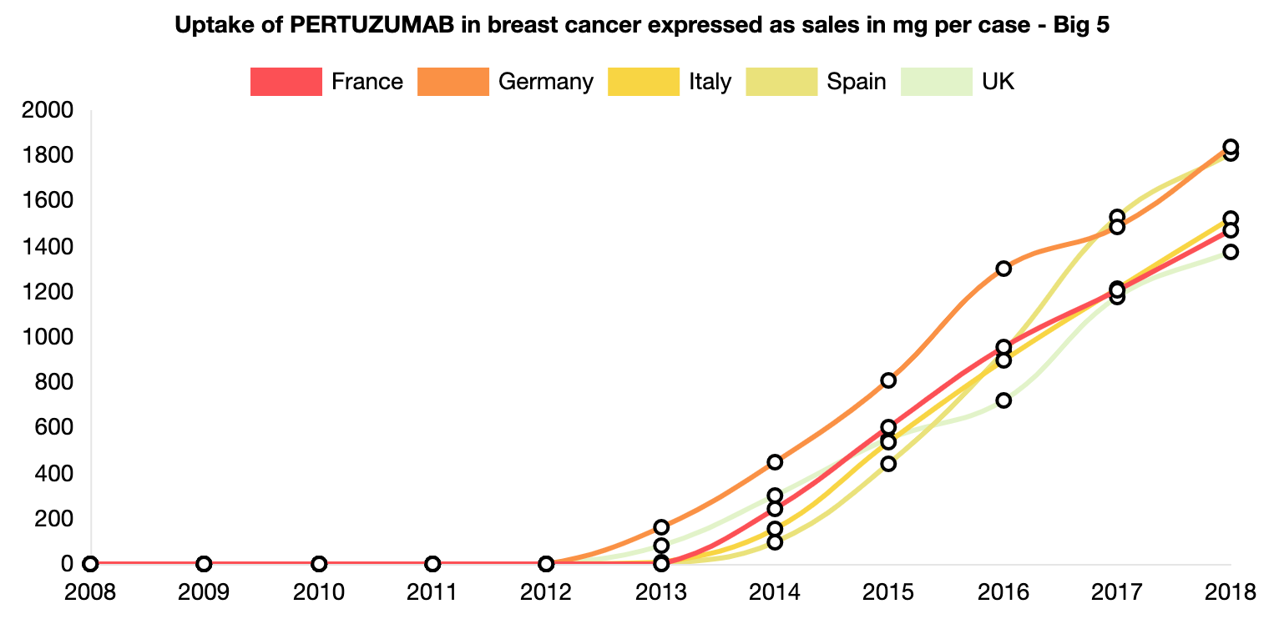
MEDICINES UPTAKE Breast Cancer Medicines
There has been a distinct increase in the number of approved cancer medicines and indications in recent years. Treatments for over 160 indications were approved since 1995. However, variation in cancer medicine uptake across Europe suggests differing levels of patient access to treatment.
Countries with a lower GDP recorded around one third to half of the level of uptake (in volume) of the EU-5 countries and other countries with a higher GDP. Among the EU-5, the UK showed a consistent pattern of the lowest level of uptake across the seven cancer types considered in this report, including immunotherapy. France and Germany had the highest level of uptake among the EU-5.
For more information on cancer medicines in Europe, you can access the report here.
Hofmarcher, T et al. (2019) Comparator Report on Cancer in Europe 2019 - Disease Burden, Costs and Access to Medicines. IHE Report 2019:7. IHE: Lund, Sweden. For further information, please follow: https://efpia.eu/cancer-comparator-report/

Slide 12
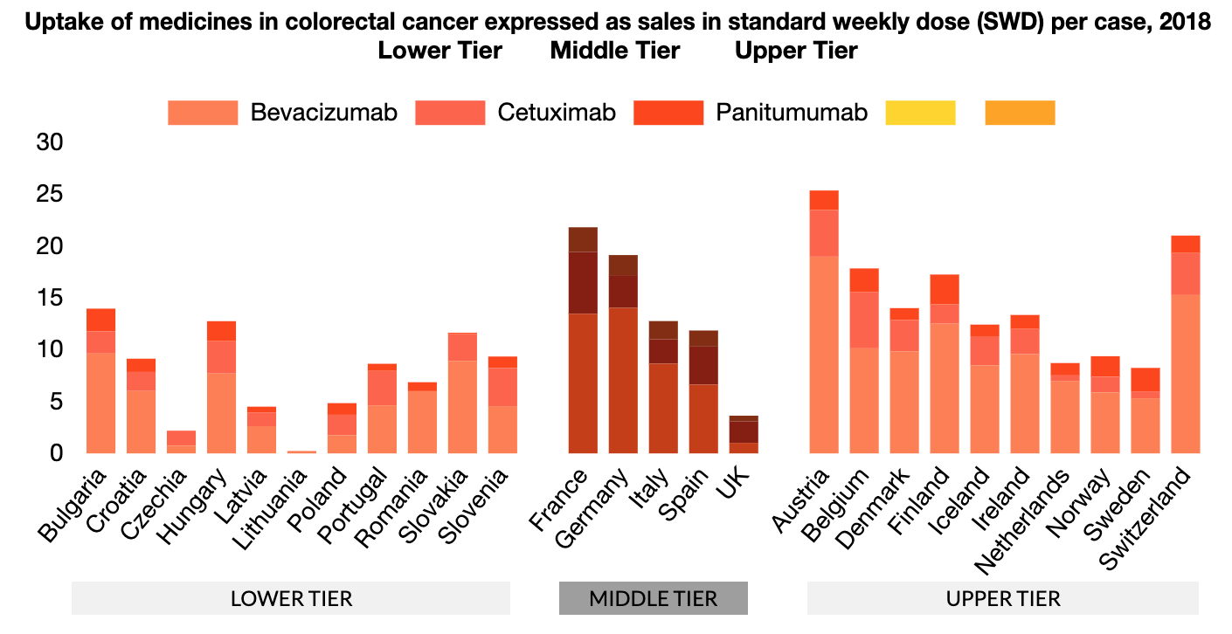
MEDICINES UPTAKE Colon Cancer Medicines
There has been a distinct increase in the number of approved cancer medicines and indications in recent years. Treatments for over 160 indications were approved since 1995. However, variation in cancer medicine uptake across Europe suggests differing levels of patient access to treatment.
Countries with a lower GDP recorded around one third to half of the level of uptake (in volume) of the EU-5 countries and other countries with a higher GDP. Among the EU-5, the UK showed a consistent pattern of the lowest level of uptake across the seven cancer types considered in this report, including immunotherapy. France and Germany had the highest level of uptake among the EU-5.
For more information on cancer medicines in Europe, you can access the report here.
Hofmarcher, T et al. (2019) Comparator Report on Cancer in Europe 2019 - Disease Burden, Costs and Access to Medicines. IHE Report 2019:7. IHE: Lund, Sweden. For further information, please follow: https://efpia.eu/cancer-comparator-report/

Slide 13
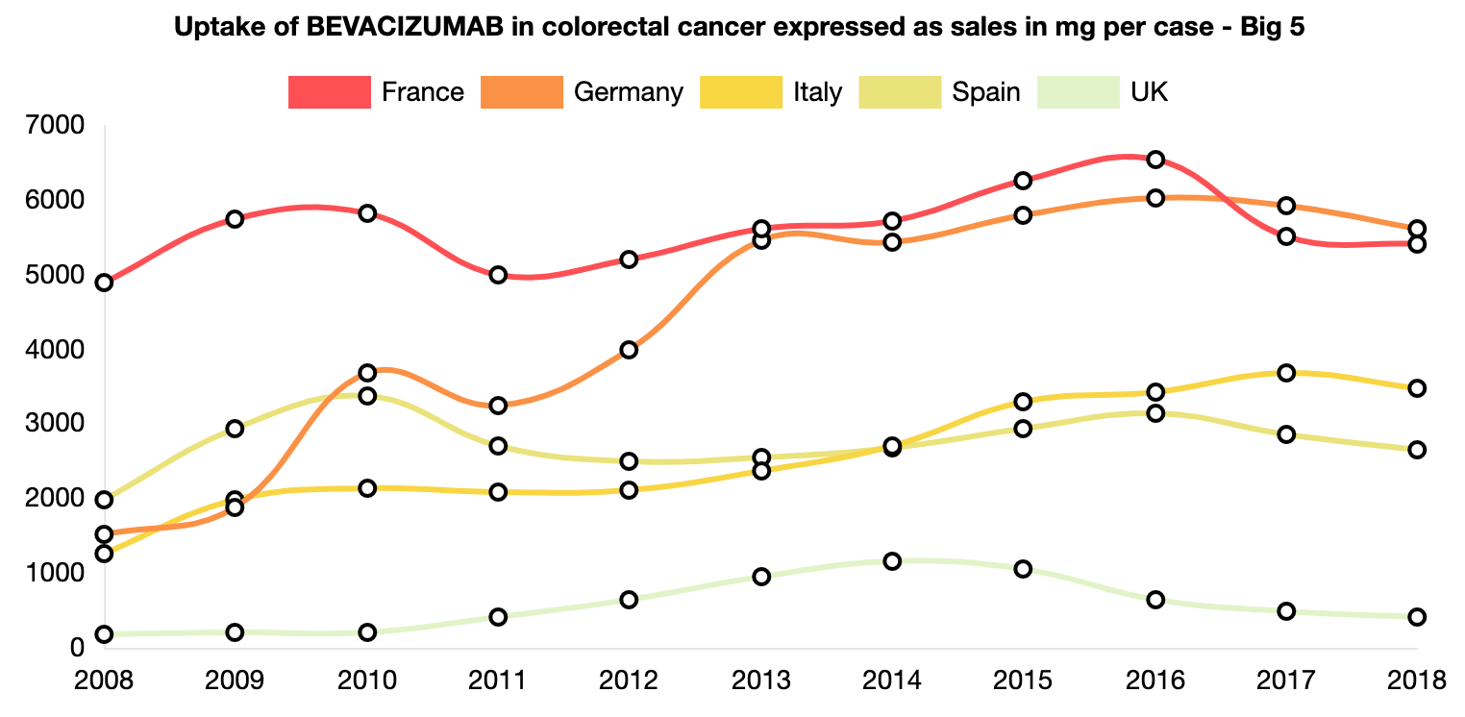
MEDICINES UPTAKE Colon Cancer Medicines
There has been a distinct increase in the number of approved cancer medicines and indications in recent years. Treatments for over 160 indications were approved since 1995. However, variation in cancer medicine uptake across Europe suggests differing levels of patient access to treatment.
Countries with a lower GDP recorded around one third to half of the level of uptake (in volume) of the EU-5 countries and other countries with a higher GDP. Among the EU-5, the UK showed a consistent pattern of the lowest level of uptake across the seven cancer types considered in this report, including immunotherapy. France and Germany had the highest level of uptake among the EU-5.
For more information on cancer medicines in Europe, you can access the report here.
Hofmarcher, T et al. (2019) Comparator Report on Cancer in Europe 2019 - Disease Burden, Costs and Access to Medicines. IHE Report 2019:7. IHE: Lund, Sweden. For further information, please follow: https://efpia.eu/cancer-comparator-report/

Slide 14
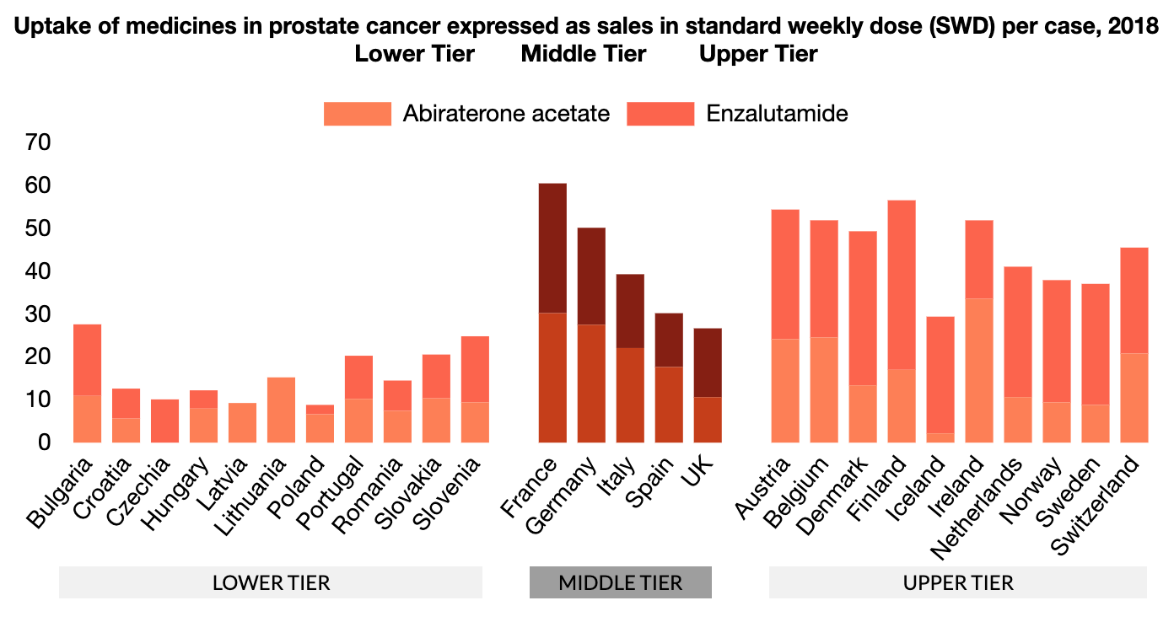
MEDICINES UPTAKE Prostate Cancer Medicines
There has been a distinct increase in the number of approved cancer medicines and indications in recent years. Treatments for over 160 indications were approved since 1995. However, variation in cancer medicine uptake across Europe suggests differing levels of patient access to treatment.
Countries with a lower GDP recorded around one third to half of the level of uptake (in volume) of the EU-5 countries and other countries with a higher GDP. Among the EU-5, the UK showed a consistent pattern of the lowest level of uptake across the seven cancer types considered in this report, including immunotherapy. France and Germany had the highest level of uptake among the EU-5.
For more information on cancer medicines in Europe, you can access the report here.
Hofmarcher, T et al. (2019) Comparator Report on Cancer in Europe 2019 - Disease Burden, Costs and Access to Medicines. IHE Report 2019:7. IHE: Lund, Sweden. For further information, please follow: https://efpia.eu/cancer-comparator-report/

Slide 15
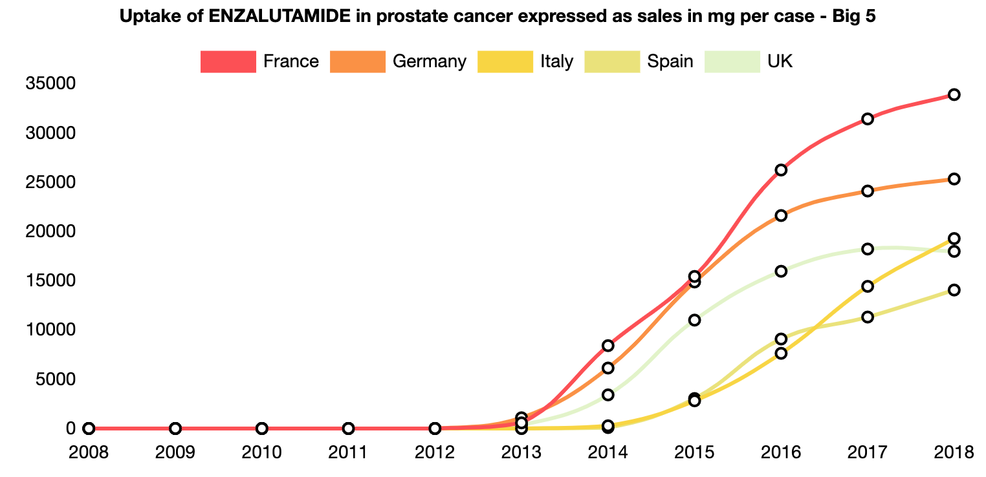
MEDICINES UPTAKE Prostate Cancer Medicines
There has been a distinct increase in the number of approved cancer medicines and indications in recent years. Treatments for over 160 indications were approved since 1995. However, variation in cancer medicine uptake across Europe suggests differing levels of patient access to treatment.
Countries with a lower GDP recorded around one third to half of the level of uptake (in volume) of the EU-5 countries and other countries with a higher GDP. Among the EU-5, the UK showed a consistent pattern of the lowest level of uptake across the seven cancer types considered in this report, including immunotherapy. France and Germany had the highest level of uptake among the EU-5.
For more information on cancer medicines in Europe, you can access the report here.
Hofmarcher, T et al. (2019) Comparator Report on Cancer in Europe 2019 - Disease Burden, Costs and Access to Medicines. IHE Report 2019:7. IHE: Lund, Sweden. For further information, please follow: https://efpia.eu/cancer-comparator-report/

Slide 16
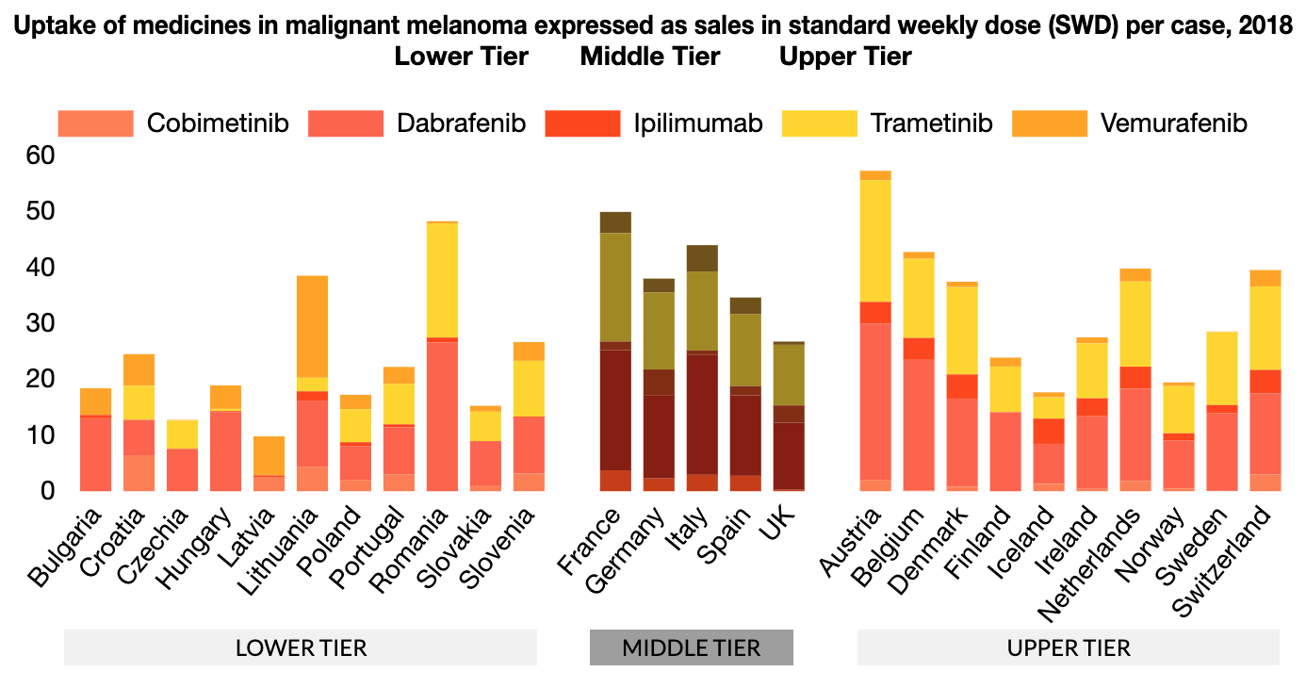
MEDICINES UPTAKE Melanoma Medicines
There has been a distinct increase in the number of approved cancer medicines and indications in recent years. Treatments for over 160 indications were approved since 1995. However, variation in cancer medicine uptake across Europe suggests differing levels of patient access to treatment.
Countries with a lower GDP recorded around one third to half of the level of uptake (in volume) of the EU-5 countries and other countries with a higher GDP. Among the EU-5, the UK showed a consistent pattern of the lowest level of uptake across the seven cancer types considered in this report, including immunotherapy. France and Germany had the highest level of uptake among the EU-5.
For more information on cancer medicines in Europe, you can access the report here.
Hofmarcher, T et al. (2019) Comparator Report on Cancer in Europe 2019 - Disease Burden, Costs and Access to Medicines. IHE Report 2019:7. IHE: Lund, Sweden. For further information, please follow: https://efpia.eu/cancer-comparator-report/

Slide 17
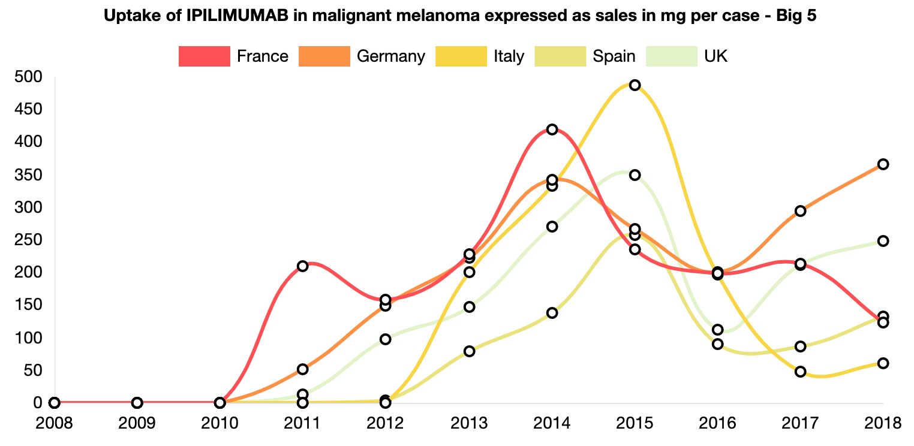
MEDICINES UPTAKE Melanoma Medicines
There has been a distinct increase in the number of approved cancer medicines and indications in recent years. Treatments for over 160 indications were approved since 1995. However, variation in cancer medicine uptake across Europe suggests differing levels of patient access to treatment.
Countries with a lower GDP recorded around one third to half of the level of uptake (in volume) of the EU-5 countries and other countries with a higher GDP. Among the EU-5, the UK showed a consistent pattern of the lowest level of uptake across the seven cancer types considered in this report, including immunotherapy. France and Germany had the highest level of uptake among the EU-5.
For more information on cancer medicines in Europe, you can access the report here.
Hofmarcher, T et al. (2019) Comparator Report on Cancer in Europe 2019 - Disease Burden, Costs and Access to Medicines. IHE Report 2019:7. IHE: Lund, Sweden. For further information, please follow: https://efpia.eu/cancer-comparator-report/

Slide 18
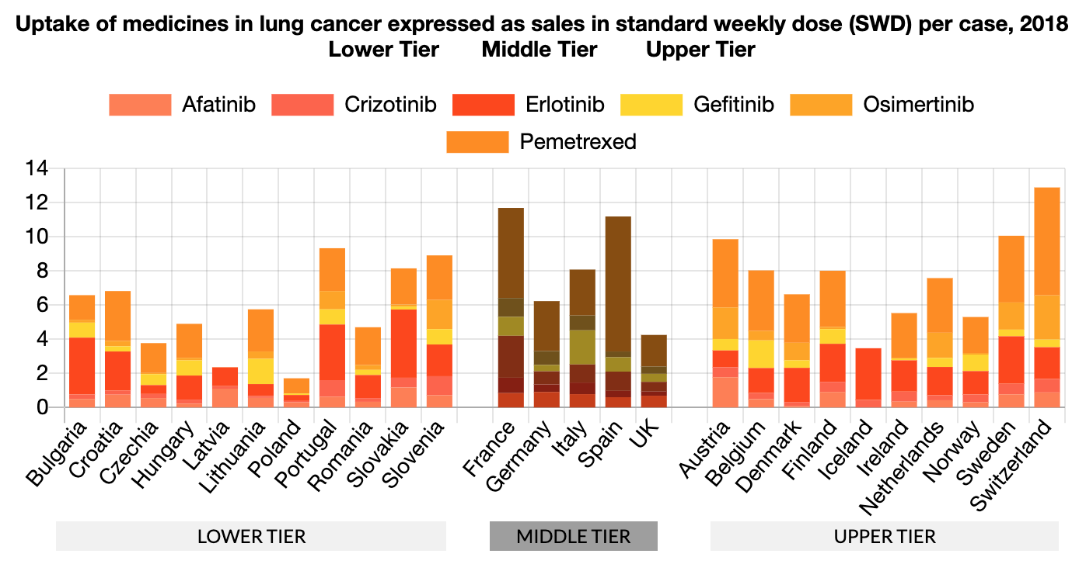
MEDICINES UPTAKE Lung Cancer Medicines
There has been a distinct increase in the number of approved cancer medicines and indications in recent years. Treatments for over 160 indications were approved since 1995. However, variation in cancer medicine uptake across Europe suggests differing levels of patient access to treatment.
Countries with a lower GDP recorded around one third to half of the level of uptake (in volume) of the EU-5 countries and other countries with a higher GDP. Among the EU-5, the UK showed a consistent pattern of the lowest level of uptake across the seven cancer types considered in this report, including immunotherapy. France and Germany had the highest level of uptake among the EU-5.
For more information on cancer medicines in Europe, you can access the report here.
Hofmarcher, T et al. (2019) Comparator Report on Cancer in Europe 2019 - Disease Burden, Costs and Access to Medicines. IHE Report 2019:7. IHE: Lund, Sweden. For further information, please follow: https://efpia.eu/cancer-comparator-report/

Slide 19
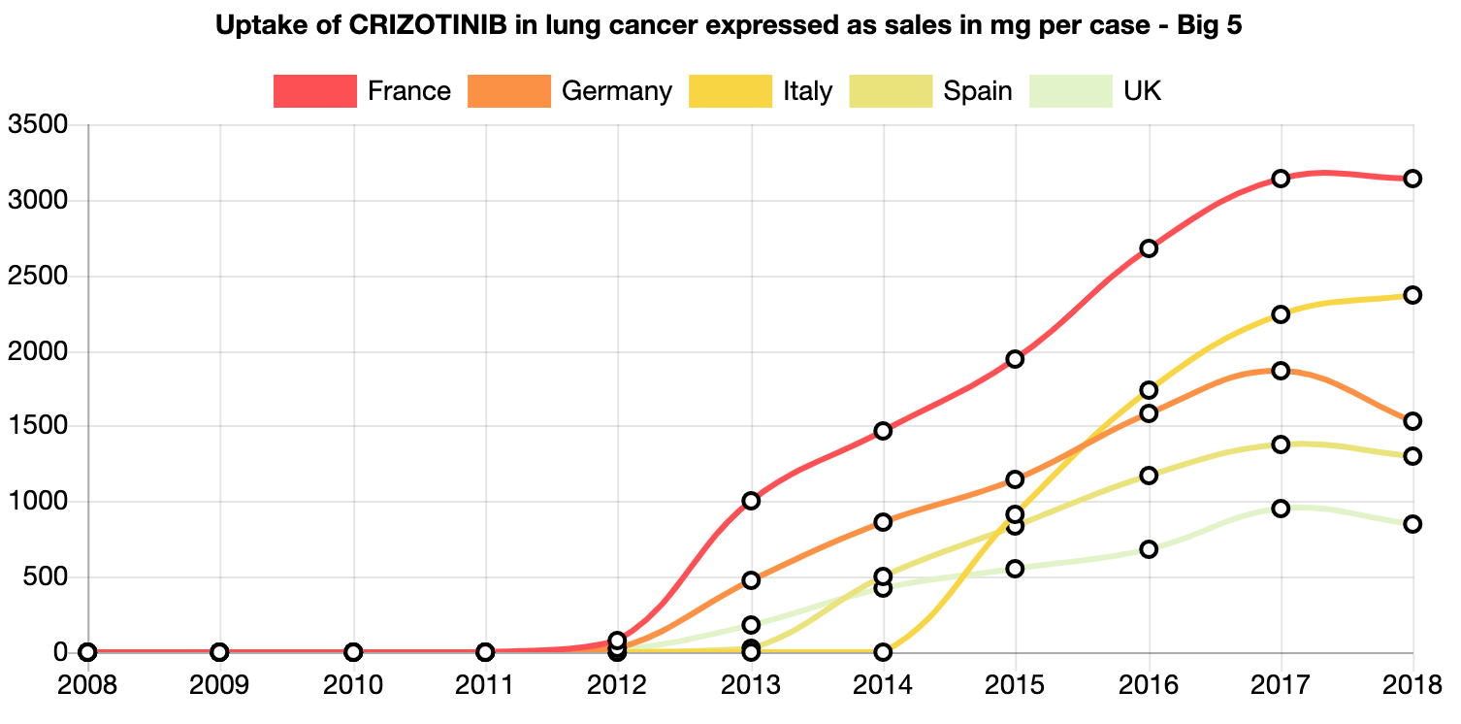
MEDICINES UPTAKE Lung Cancer Medicines
There has been a distinct increase in the number of approved cancer medicines and indications in recent years. Treatments for over 160 indications were approved since 1995. However, variation in cancer medicine uptake across Europe suggests differing levels of patient access to treatment.
Countries with a lower GDP recorded around one third to half of the level of uptake (in volume) of the EU-5 countries and other countries with a higher GDP. Among the EU-5, the UK showed a consistent pattern of the lowest level of uptake across the seven cancer types considered in this report, including immunotherapy. France and Germany had the highest level of uptake among the EU-5.
For more information on cancer medicines in Europe, you can access the report here.
Hofmarcher, T et al. (2019) Comparator Report on Cancer in Europe 2019 - Disease Burden, Costs and Access to Medicines. IHE Report 2019:7. IHE: Lund, Sweden. For further information, please follow: https://efpia.eu/cancer-comparator-report/

Slide 20
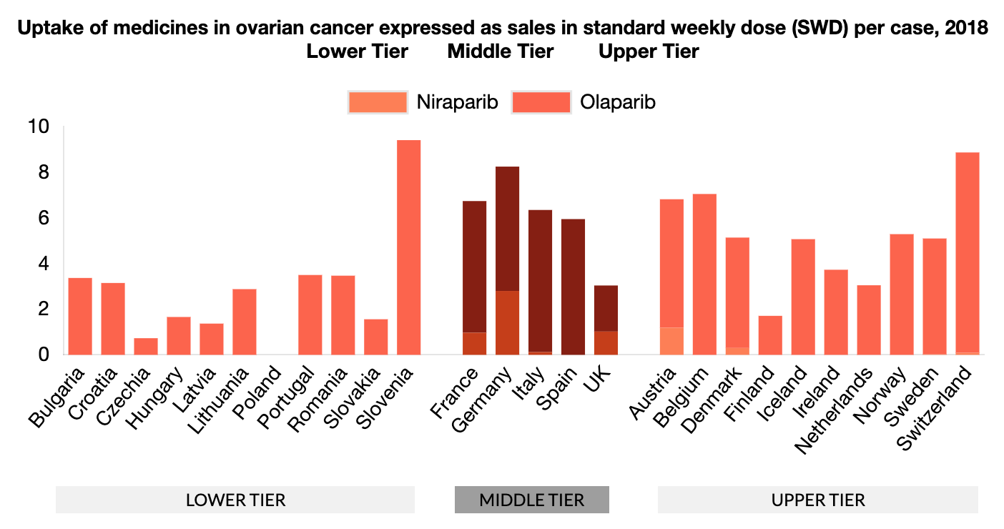
MEDICINES UPTAKE Ovarian Cancer Medicines
There has been a distinct increase in the number of approved cancer medicines and indications in recent years. Treatments for over 160 indications were approved since 1995. However, variation in cancer medicine uptake across Europe suggests differing levels of patient access to treatment.
Countries with a lower GDP recorded around one third to half of the level of uptake (in volume) of the EU-5 countries and other countries with a higher GDP. Among the EU-5, the UK showed a consistent pattern of the lowest level of uptake across the seven cancer types considered in this report, including immunotherapy. France and Germany had the highest level of uptake among the EU-5.
For more information on cancer medicines in Europe, you can access the report here.
Hofmarcher, T et al. (2019) Comparator Report on Cancer in Europe 2019 - Disease Burden, Costs and Access to Medicines. IHE Report 2019:7. IHE: Lund, Sweden. For further information, please follow: https://efpia.eu/cancer-comparator-report/

Slide 21
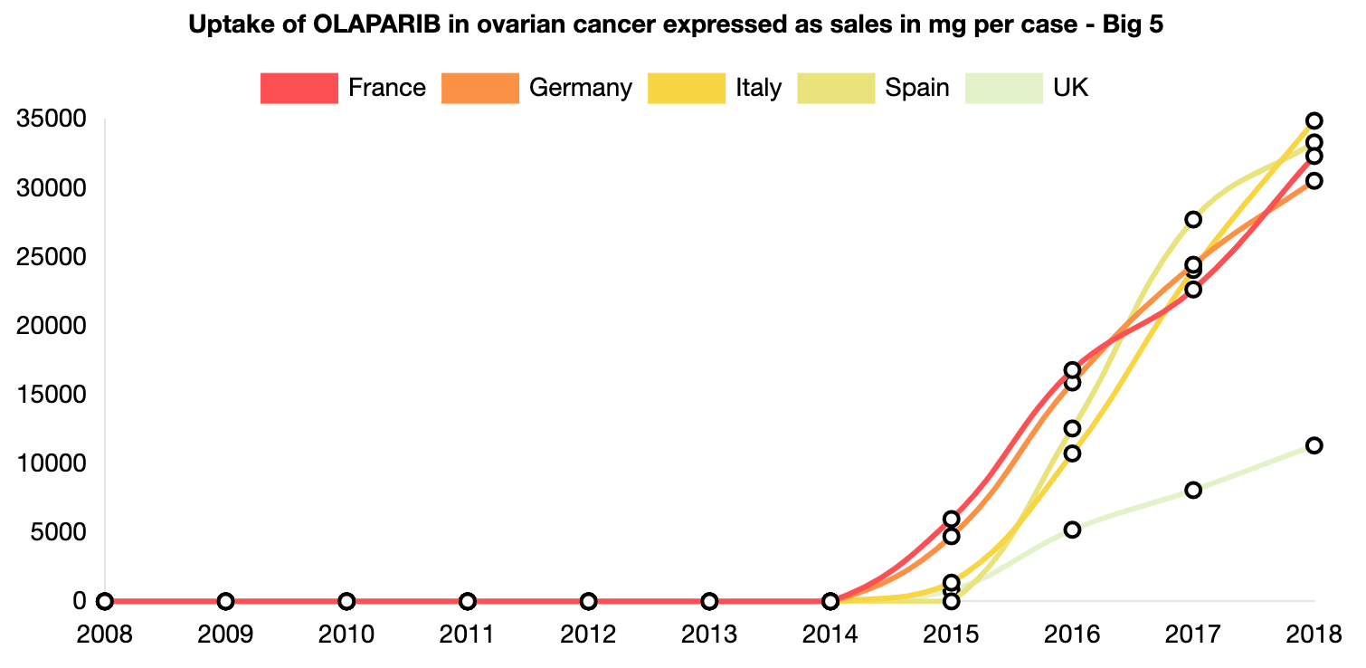
MEDICINES UPTAKE Ovarian Cancer Medicines
There has been a distinct increase in the number of approved cancer medicines and indications in recent years. Treatments for over 160 indications were approved since 1995. However, variation in cancer medicine uptake across Europe suggests differing levels of patient access to treatment.
Countries with a lower GDP recorded around one third to half of the level of uptake (in volume) of the EU-5 countries and other countries with a higher GDP. Among the EU-5, the UK showed a consistent pattern of the lowest level of uptake across the seven cancer types considered in this report, including immunotherapy. France and Germany had the highest level of uptake among the EU-5.
For more information on cancer medicines in Europe, you can access the report here.
Hofmarcher, T et al. (2019) Comparator Report on Cancer in Europe 2019 - Disease Burden, Costs and Access to Medicines. IHE Report 2019:7. IHE: Lund, Sweden. For further information, please follow: https://efpia.eu/cancer-comparator-report/

