Slide 1








From innovation to outcomes; medicines costs in context
Author: Andrew Powrie-Smith * Date: 05/04/2016 * Version: DRAFT
Pricing
^{www.efpia.eu}

Slide 2

SECTION 1: The value of medicines to patients, healthcare systems and society
PATIENTS
ECONOMIES
    Patients live longer, healthier, more productive lives
The biopharmaceutical industry generates essential economic value in terms of job creation, R&D investment, and medications that improve patient productivity
HEALTHCARE SYSTEMS
SOCIETY
HEALTHCARE SYSTEMS
Innovative medicines can put healthcare systems on a more sustainable path by reducing costs in other parts of the healthcare system such as hospitlisations
Society benefits from health and wellness as individuals are able to continue being productive members of the community

Slide 3
With over 7000 medicines in development, the exciting new wave of medical innovation will play a key role in
addressing the challenges faced by patients and healthcare systems
Medicines in Development Worldwide
Biopharmaceutical companies are focusing on areas of high unmet need
Biopharmaceutical companies have made significant gains in key disease areas
HIV/AIDS is now a manageable, chronic disease, thanks to prior advances in biopharmaceutical research
Note: Defined as single products which are counted exactly once regardless of the number of indications pursued.
Source: Health Advances analysis; Adis R&D Insight Database.

Slide 4
Value to patients
Patients all over the Europe are living longer, healthier and more productive lives thanks to innovative medicines developed by biopharmaceutical companies.

Slide 5
Medicines are some of the most powerful tools in
treating and curing diseases
95%
Of the 15 million patients in Europe living with Hepatitis C Can be cured through an 8-12 week course of treatment.
 | Between 2000 and 2012, the death rate from cardiovascular disease fell 37% in the EU5.
 | Between 2000 and 2012, new therapies contributed to a 48% and 31% decline in the diabetes death rate in Korea and Canada, respectively.²
 | Since 1991 there has been a 21% reduction in mortality rates from all cancers
37%
31%
21%
94%
Since 1991 there has been a 94% reduction in age-standardised death rates for patients living with HIV in France
Source: Health Advances analysis; ¹PhRMA 2016 Prescription Medicines: Costs in Context; ²WHO Mortality Database (accessed February 2016).2. ²EFPIA 2015 Health & Growth Evidence Compendia analysis of PhRMA 2014 25 Years of Progress Against Hepatitis C and PhRMA 2015 Pharma Profile

Slide 6
Value to healthcare systems
Innovative medicines can put healthcare systems on a more sustainable path by reducing costs in other parts of the healthcare system such as hospitalisations and clinicians time
.

Slide 7
Medicine use yields
Significant health gains and savings in other parts of the healthcare systems
New Cardiovascular Medicines Led to Direct Savings on Hospitalizations in 20 OECD Countries*, 1995-2004
1.6-2.1 million
The number of influenza cases averted with the current use of seasonal influenza vaccination in Europe.¹
€250-330 million
Per capita expenditure on cardiovascular hospitalizations would have been $89 (70%) higher in 2004 had new cardiovascular medicines not been introduced in the period 1995–2004.²
Total influenza-related costs saved annually from averted GP visits, hospitalizations, and lost days of work as a result of the current use of seasonal influenza vaccination in Europe.¹
* Countries included: EU5, Australia, Austria, Belgium, Canada, Czech Republic, Finland, Hungary, Japan, Korea, New Zealand, Norway, Poland, Slovak Republic, Spain, Switzerland, Turkey, USA.
Source: Health Advances analysis; ¹Preaud 2014 Annual public health and economic benefits of seasonal influenza vaccination; ²Lichtenberg 2009 Have newer CV drugs reduced hospitalization in 20 OECD countries Health Econ.

Slide 8
Value to the Economy
The biopharmaceutical industry generates essential economic value in terms of job creation, R&D investment, and medications that improve patient productivity

Slide 9
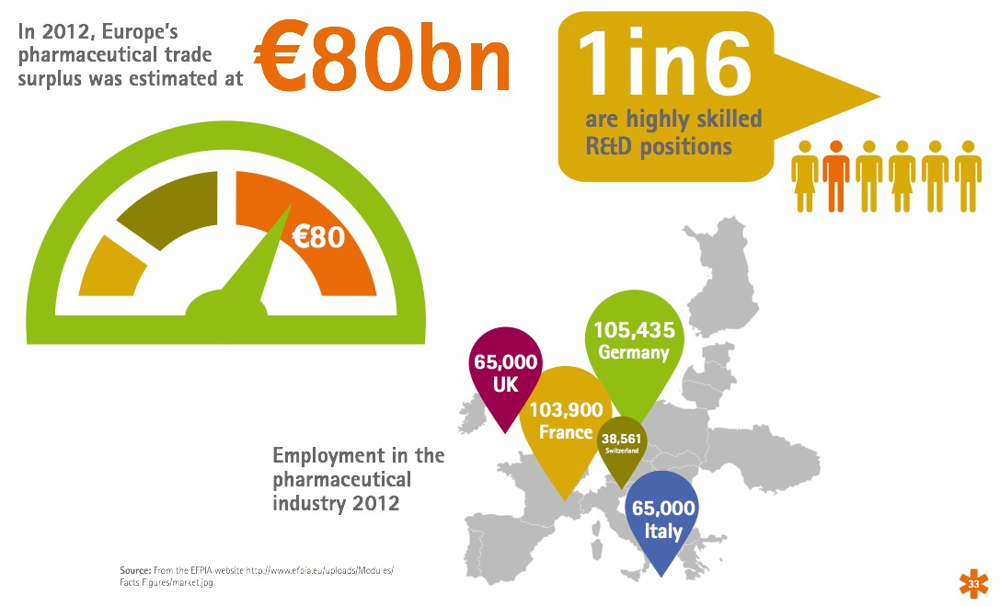
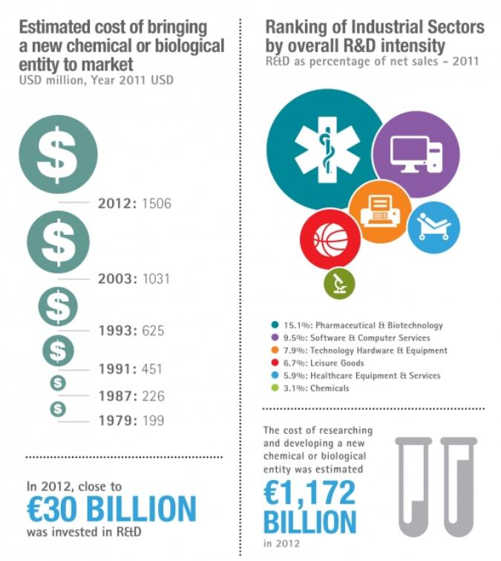
The biopharmaceutical industry makes a significant contribution to the European economy
The pharmaceutical industry invests more of its revenue in generating new knowledge through research and development than other sectors

Slide 10
Value to society
Innovation can deliver significant societal value as development is strongly targeted at societal disease priorities and patients are able to continue contributing to the community.

Slide 11
Innovative new therapies have enabled patients to
Continue contributing to society
Cancer
The overall rate of returning to work following a cancer diagnosis has grown to over 75% due to innovative therapies²
In France, 82.1% of working women diagnosed with breast cancer returned to work after a median sick leave of 10.8 months⁴
In the Netherlands, 83% of working individuals diagnosed with head and neck cancer returned to work, and most often within 6 months after treatment⁵
In Japan, 81% of patients diagnosed with cancer returned to work within 12 months of their initial sick leave³
  Note: In all three studies, return to work includes full-time and part-time work.
Source: Health Advances analysis; ²Amir Z 2009 Cancer Survivorship and employment Occup Med; ³Endo 2015 Returning to work after sick leave due to cancer: a 365-day cohort study of Japanese cancer survivors J Cancer Surv; ⁴Fantoni 2010 Factors related to return to work by women with breast cancer in Northern France J Occup Rehab; ⁵Verdonck-de Leeuw 2010 Employment and return to work in head and neck cancer survivors Oral Oncol.

Slide 12
Section 2:
  Putting the spending on medicines in Europe in context; separating fact from fiction

Slide 13
Total healthcare expenditure has been growing since the 1990s while the pharmaceutical spending declined from 2010 to 2013
Across Europe, expenditures on total healthcare are growing faster than growth in pharmaceutical expenditures
Expenditure per capita (2004-2012, 25 European OECD Countries, population-weighted, current prices, PPP, $)
Note: Countries include Austria, Belgium, Czech Republic, Denmark, Estonia, Finland, France, Germany, Greece, Hungary, Iceland, Ireland, Italy, Luxembourg, Netherlands, Norway, Poland, Portugal, Slovak Republic, Slovenia, Spain, Sweden, Switzerland, Turkey, United Kingdom.
Source: OECD health statistics compiled by EFPIA for the health and growth evidence compendium 2015

Slide 14
Spending on medication is
A small percentage of total disease spending
In Germany, medication spending is a small share of the total cost of many chronic diseases
COPD
CHF
Pharmaceutical Spend as a Percent of
Total Disease Spending, 2011
Diabetes
Alzheimer’s
Source: Health Advances analysis; EFPIA 2015 Health & Growth Evidence Compendia analysis of A.T. Kearney analysis 2012, Schwarzkop et al. 2010, and Damm et al. (2012).

Slide 15











Innovation and affordability is promoted through the prescription drug life cycle as
Pharmaceutical drug cost decline over time
Combination of generic price erosion and price regulation resulted in a 24% decline in medicine prices versus a 30% rise in consumer prices in Europe from 2000 through 2013.
Consumer Price Index (CPI) vs. Medicines Price Index, Population weighted, Year 2000 = Index 100
Population-Weighted, Europe
130
Price Index,
Year 2000 = Index 100
CPI
Medicines Price Index
76
Source: Health Advances analysis; EFPIA 2015 Sustainable Healthcare Systems Compendia analysis of various OECD databases (accessed in April 2015), Austria: pharmig based IFP; Belgium: Pharma.be; Finland: Pharma Industry Finland based on Statistic Finland; France: Leem based on INSEE; Germany: vfla based on GKV; Greece: SFEE based on Eurostat; Italy: farmindustria based on ISTAT; Spain: Farindustria based on INE; Sweden: LIF Sweden based on Apotekens Service, Netherlands: Farmingform based on the Central bureau of Statistics.

Slide 16
Initiatives focusing on health outcomes instead of only cost containment can Both
Improve quality of care and reduce costs
Total Cost of Healthcare per Patient (Euros)
A recent study in Sweden targeting disease management found that patients enrolled in a heart failure program involving regular follow-up* with specialized nurses led to
improved outcomes and 30% reduced costs
through fewer hospital admissions and GP visits
* Regular follow up included frequent phone and in-person follow-ups with nurses and physicians to optimize patient’s heart failure treatment according to current guidelines, as well as receipt of information about heart failure from a validated computer-based awareness program.
Source: Health Advances analysis, Agvall 2014 Resource use and cost implications of implementing a heart failure program for patients with systolic heart failure in Swedish primary health care International J Cardiology.

Slide 17
Section 3:
  The challenges in delivering innovative medicines to patients

Slide 18
Despite Great Progress,
Challenges loom threatening continued innovation and patient access to medicines
INNOVATION IS HARDER
AND MORE COSTLY
INVESTMENT IN INNOVATION INCREASINGLY RISKY
Longer, more complex clinical trials
Government payers encouraging off label use of therapies to save money
Higher regulatory hurdles
Flourishing parallel trade
BIOPHARMA INNOVATION
Increased cost of R&D
Fiscal austerity measures
Unknown IP environment
CHALLENGES EXIST IMPEDING PATIENT ACCESS
Complex HTA processes delaying patient access
Clinical guidelines and restrictive cost-effectiveness requirements limiting access to best care
Contracting and tendering limiting therapeutic options

Slide 19
Section 4:
  Pharmaceutical companies in Europe are working with governments and healthcare systems in Europe to find solutions to Europe’s healthcare challenges

Slide 20
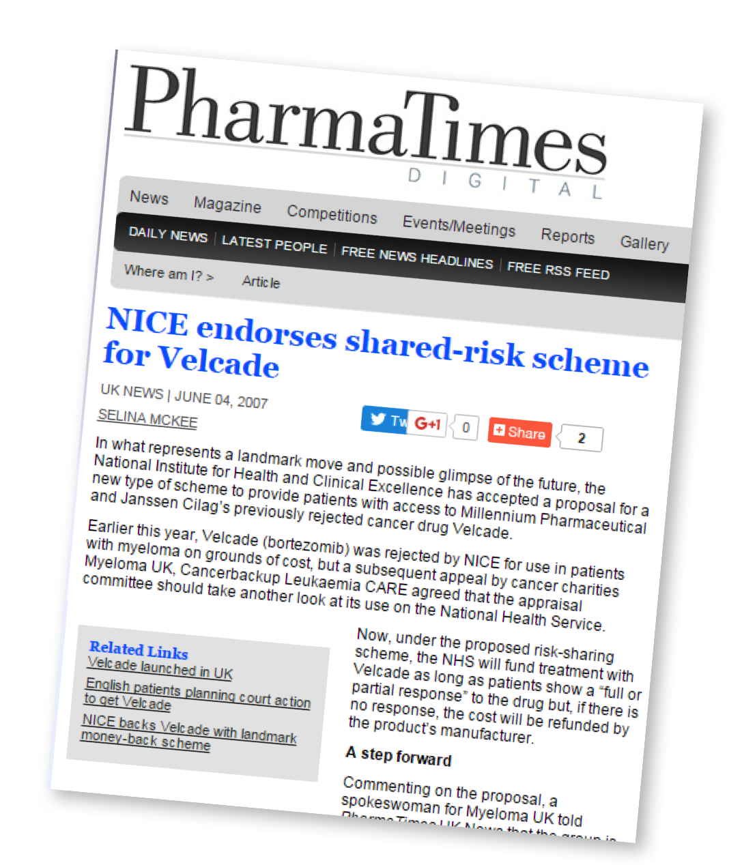
To support the shared objective of rapid access to the latest effective and life-saving medicines, industry remains committed to engaging with payers on flexible and innovative pricing and funding models
Outcomes-based reimbursement
Patient access schemes
Managed entry agreements for new medicines
A pioneering patient access scheme between industry and health services for the multiple myeloma treatment bortezomib in the UK saw reimbursement for patients who did not respond after four treatment cycles covered directly by the manufacturer with an average potential saving of GBP 12,198 per non-responsive patient1

Slide 21

Industry is keen to engage in the debate and to partner with payers to deliver outcomes driven sustainable healthcare systems
The objective of outcomes-focused healthcare systems is to deliver better patient outcomes at the same or lower cost...
relying on quality outcome data
as starting point to improve care cycle
Holistic approach
Transparent, high-quality
outcomes data
Medicines
Analyze
variation
Health
information
Care
management
Feedback
and
learning
Patient
Identify
current best
practices
MedTech
Care delivery
Change
behavior
Outcome
=
Value
Value
Cost
Benefits of a focus on outcomes: improved patient outcomes, reduced variation, reduced medical cost, continuous improvement

Slide 22
Medicines are Part of the Solution…
and more can be done together
Governments, Providers, and National Payers
IMPROVE EFFICIENCY
PAY FOR VALUE
FIND SOLUTIONS
Look at all healthcare costs, reduce administrative costs and waste, and improve efficiency.
Support evidence-based care and empowered patients and providers, backed by sound research and strong quality measures.
Avoid blanket policies that chill investment, and collaborate to find new approaches.
CONTINUE DEVELOPING INNOVATIVE THERAPIES, PROMOTE MEDICATION ADHERANCE, MAINTAIN EFFORTS TO SUPPORT BROAD PATIENT ACCESS
Biopharmaceutical Companies

Slide 23
^{EFPIA Brussels Office}
Leopold Plaza Building * Rue du Trône 108
^{B-1050 Brussels * Belgium}
^{Tel: + 32 (0)2 626 25 55}
^{www.efpia.eu * info@efpia.eu}

