Slide 1
Overview of the pharmaceutical industry in Europe
Dr Richard Torbett
Chief Economist, EFPIA
China/ EU Pharmaceutical Industry Forum
Shanghai, 16 May 2015

Slide 2
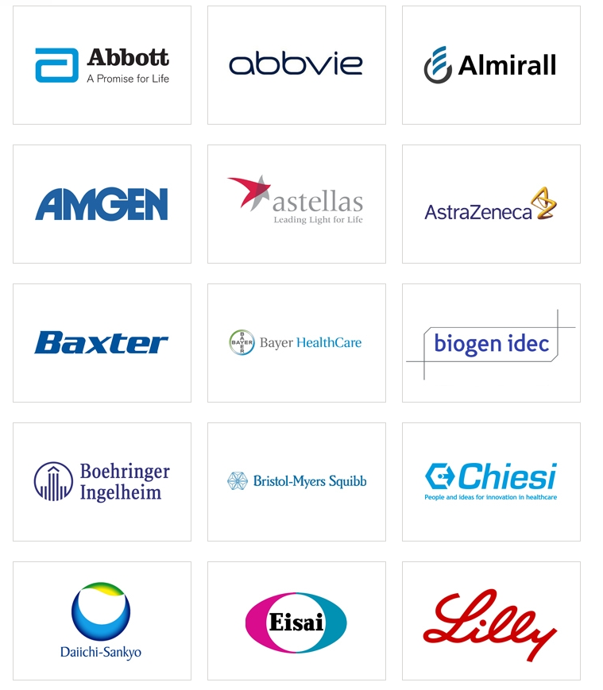
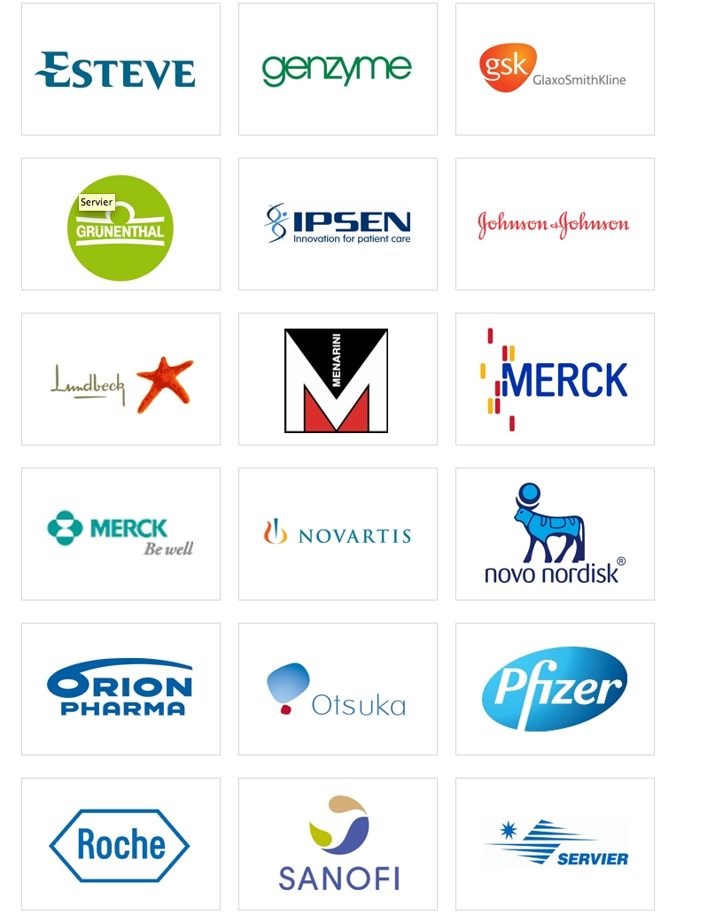
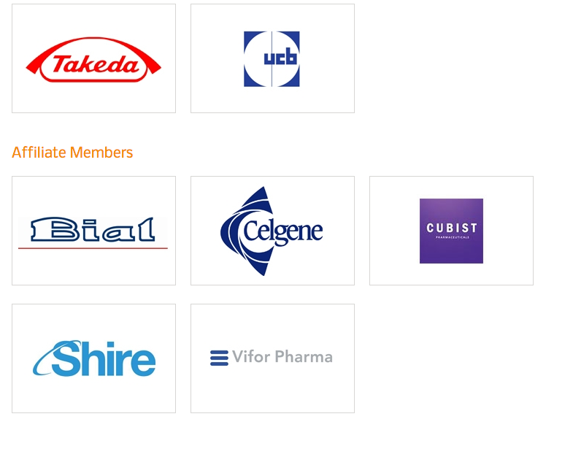
Introducing EFPIA
The European Federation of Pharmaceutical Industries and Associations (EFPIA) represents the pharmaceutical industry operating in Europe. Through its direct membership of 33 national associations and 40 leading pharmaceutical companies, EFPIA is the voice on the EU scene of 1,900 companies. EFPIA counts two specialised companies : Vaccines Europe (VE) and European Biopharmaceutical Enterprises (EBE).

Slide 3
Over the last 60 years Europe has made great strides in improving health outcomes resulting in a 14-17 % increase in life expectancy
Health & Wealth
Life expectancy at birth for EU27 countries (1950-2010)
Life Expectancy (years)
During the last 60 years, both male and female life expectancies have improved substantially across Europe.
+17%
+14%
0
Time Period
Source: United Nations: World Population Prospects – The 2010 Revision (2011)

Slide 4
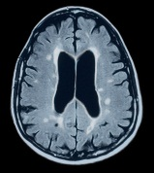
Medicines Are Transforming the Treatment of Many Difficult Diseases
HIV/AIDS
In the last two decades, advances in treatment have contributed to a more than 80% decline in death rates and transformed the disease from an acute, fatal illness to a chronic condition.
Multiple Sclerosis
Oral and biologic treatments approved over the past 15 years have dramatically improved outcomes for MS patients, slowing disability progression and offering fewer relapses.
Rheumatoid Arthritis
Therapeutic advances have transformed the RA treatment paradigm over the last 20 years, from focusing on symptom management to now aiming for slowed disease progression and even disease remission.
Cancer
New therapies have contributed to a 20% decline in cancer deaths since the 1990s. Today, 2 out of 3 people diagnosed with cancer survive at least 5 years.
Notes:
The National Multiple Sclerosis Society. “The MS Disease-modifying Medications: General Information.” Washington, DC: National Multiple Sclerosis Society, April 2013. Available at www.nationalmssociety.org/NationalMSSociety/media/MSNationalFiles/Brochures/12-3-7_DiseaseModifyingDrugs.pdf.
C. Augustyn, B. Walker, and T.F. Goss. “Recognizing the Value of Innovation in the Treatment of Rheumatoid Arthritis.” Boston, MA: Boston Healthcare Associates, March 2013. Available at www.phrma.org/sites/default/files/1888/rawhitepaperfinal2.pdf.
U.S. Department of Health and Human Services, Centers for Disease Control and Prevention, National Center for Health Statistics. “Health, United States, 2010: With Special Feature on Death and Dying, table 35.” Hyattsville, MD: HHS, 2011. Available at www.cdc.gov/nchs/data/hus/hus10.pdf#045 (accessed February 2014).
American Cancer Society. “Cancer Treatment and Survivorship Facts & Figures 2012−2013.” Atlanta, GA: American Cancer Society, 2012.

Slide 5
Industry continues to invest significantly in R&D, driving one of the highest value added relative to other industries
Ranking of industrial sectors by overall R&D intensity*
Value added vs. changes in R&D intensity†
Pharmaceuticals & Biotechnology
15.1%
Pharmaceuticals
Software & computer services
% Growth in value-added (2001-2007)
Technology hardware & equipment
Motor vehicles
Leisure goods
Other transport equipment
Health care equipment & services
Electronic & electrical equipment
Automobiles & parts
Aerospace & defence
Chemicals excluding pharmaceuticals
All sectors
Aerospace
Chemicals
Industrial engineering
General industrials
Fixed line telecomunnications
Radio, TV and communication equipment
Food producers
Banks
Oil & gas producers
R&D intensity gain/loss (1995-2006)
R&D as percentage of net sales (2012)
Gross output at market prices, 2007
Note: R&D intensity gain/loss calculated as difference between average R&D intensity in 1995-2000 and 2001-2006
Source: * EFPIA: Pharmaceutical industry in figures (2013); † EU KLEMS Database; Eurostat; OECD STAN Indicators; European Commission: Innovation Union Competitiveness (2011)
Notes:
A word of introduction to the research-based pharmaceutical industry. The pharmaceutical sector invests more in R&D as a percentage of sales than any other industry.
Economic value added per employee in the pharmaceutical sector is higher than in comparable industries.

Slide 6
R&D employment looks stable across Europe as a whole

Slide 7
In absolute numbers, R&D investments in Europe is relatively flat; Europe’s proportion of global R&D investment however is undergoing a minor decline
Sales weighted
usable data¹
Total companies: n=20
50%
Large companies: n=11
Mid-cap companies: n= 9
54% (of big co.)
36% (of mid co.)
Worldwide R&D investment by region (%)
Worldwide R&D investment by region Worldwide (2007 = Index 100)
2007
2008
2009
2010
2011
2012
2007
2008
2009
2010
2011
2012
1. EUROPE (= 27/28 EU Member States + EFTA members)
3. JAPAN
5. Rest of the World
2. NORTH AMERICA (USA + Canada)
4. BRICMT (Brazil, Russia, India, China, Mexico, Turkey)
Source: Efpia survey on R&D, employment and sales (2013), Question III: What was the amount (in € million) that your company invested in R&D by region? 1) Sales weighted useable data: sales ratio of analyzed companies to total sales of Efpia companies and by Big / Mid Companies. Sales figures obtained from Capital IQ.

Slide 8
The industry employs over 700 000 people in Europe, accounting for 17% of total business enterprise R&D employment
Growth & Competitiveness
Employment in the pharmaceutical industry in EU (1990-2012)*
R&D jobs in pharmaceutical as a % of total R&D jobs across all business enterprises†
+40%
+52%
Source: * EFPIA: Pharmaceutical industry in figures (2013); † Eurostat - Science and Technology database (accessed March 2013)

Slide 9
Even during the financial crisis, employment in the pharmaceutical sector has proven more resilient than in other industries
Growth & Competitiveness
Percentage change in employment in select industries
Annual changes in employment
Multi-year changes in employment
Source: Eurostat: various databases (accessed 2013); A.T. Kearney analysis *% change 2003-2009

Slide 10
The pharmaceutical industry continues to drive a positive trade balance for Europe
Trade Balance for Europe (2013)
EU-27 Trade balance for high technology sectors (2013)
EUR mn
EUR mn
350 000
305 000
60 000
55629
300 000
276 357
50 000
250 000
40 000
34012
200 000
30 000
7512
18089
150 000
20 000
90 935
10 000
100 000
0
50 000
23 180
-10 000
0
-20 000
-30 000
-50 000
-16 113
-40 000
-100 000
-50 000
-44291
-42983
-150 000
-68 841
Trade balance
-200 000
Pharmaceutical products
-250 000
-214 824
Power generating machinery and equipment
-225 000
-226 500
Office machines and computers
1990
2000
2010
2012
2013
Telecommunication, sound, TV, video
Production
Imports
Electrical machinery
Exports
Trade balance
Professional, scientific, controlling material
Source: EFPIA Pharmaceutical industry in figures 2014 (2014)

Slide 11
…But Europe is consistently lagging behind the US as the place where innovators want to launch their products first
Growth & Competitiveness
Launches of new active substance by region, 2001 - 2011
Launches of new active
substance
Note: Only includes entirely novel products that were first introduced in any worldwide market during 2010 – as such it includes new chemical entities and biologics but excludes novel formulations or combination products. To be included in this analysis, the products also need to be actively launched on the market, not just approved for sale.
Source: Parexel R&D Statistical Sourcebook 2012/2013

Slide 12
EFPIA Brussels Office
Leopold Plaza Building
Rue du Trône 108
B-1050 Brussels - Belgium
Tel: +32 (0)2 626 25 55
www.efpia.eu
Notes:
Final Page

